Slide 1
MULTIPLICATION WORKSHOP
28th april 2021

Slide 2
What is the multiplication check?
This year, we are taking part in the Multiplication Check for Year 4. In 2022, this check will become statutory for all schools, following the same procedures as the previous year’s pilot.
This meeting is to explain what the check entails and how you can help your child, now and in the future.

Slide 3
Expectations.
Pupils in Year 3 are expected to know their 2,3,4,5,8,10 times tables by the end of Year 3 and be able to apply these and understand the inverse.
Pupils in Year 4 are expected to know all times tables up to 12 x 12, including the inverse operation.
E.g. 2 x4 = 8
8 /2 = 4
8/4 = 2
Pupils should be able to calculate these efficiently mentally , moving away from using fingers to support and having quick recall.

Slide 4
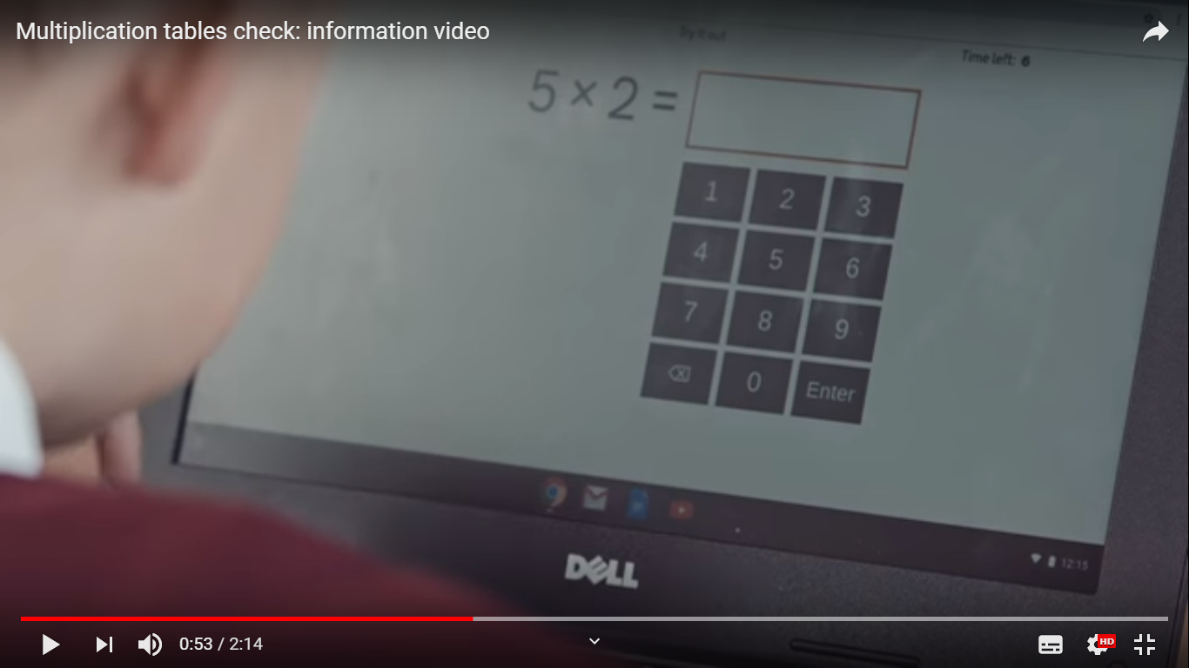
The multiplication check
(30) Multiplication tables check: information video - YouTube

Slide 5
Try it and see…
https://play.ttrockstars.com/play/soundcheck
https://mathsframe.co.uk/en/resources/resource/477/Multiplication-Tables-Check

Slide 6
Preparation in school / at home before the check
All Year 3 and 4 pupils have access to TT Rockstars and need to be practising on the site / games regularly. We are also competing against other each other in our classes and have had regular competitions, especially during lockdown .
Regular Bronze, Silver and Gold tests are being completed in school to help children succeed in their multiplication tables.
Year 4 pupils are currently being tested on their tables in school and this information, including any gaps, will be shared with parents over the next few weeks.

Slide 7
PREparation for the check
Please ensure that your child does not share their TT Rockstars password with anyone, or log onto anyone else’s account.
Please encourage them to practice their times tables daily and log onto TT Rockstars daily to practice for 10-15 mins.
Please look at those tables which your child are not confident with and help practice those additionally.
Please also practice regularly on Maths Frame using the sample check which will help your child become familiar with the test.

Slide 8
How can I help my child?
In Year 3, please make sure that your child is very secure with all of the times tables covered. Please ensure regular practice at home, using TT Rockstars and written practice. It is also about speed, 6 seconds isn’t very long, so ensure that they have rapid quick fire recall, these are great games to play in the car!
In Year 4, please work with your child to check that they know all of their times tables and practice any they are unsure of. Lots of speed games will really help!

Slide 9
Prior to the multiplication check
Each pupil will have the opportunity to have at least 1 practice test before hand. This will be done in the same setting as the actual test to reassure pupils that this is nothing to worry about.
The site allows pupils to do this in school – this is not accessible to parents and has a time limited log in.
Please use the Mathsframe site to practice at home.

Slide 10
The day of the multiplication check
Pupils will take the check individually with 2 members of staff in the room. Mrs Peel. Mrs Ryder and Mrs Dykes will oversee all of the checks. These check will take place over a period of 2 weeks. Each child will be given their own DFE log in which will enter them into the check. Each check will differ for every child so a solid knowledge of all times tables is essential.
The check will take place on an I-pad. Following trials for pupils in school, pupils were most confident and comfortable using I-pads to answer the test questions and are used in regular classroom practice.
Pupils are given 6 seconds to answer each of the questions, Once the 6 seconds are up, the question disappears and pupils must move on. There is no opportunity to go back.

Slide 11
After the check
The tests are marked immediately by the computer. Once the window for administration has closed, schools will be notified of pupil scores in July 2021. We will share these with parents and pupils after this date.
Most pupils will have a good idea which ones they got right!!
There is currently no ‘pass’ mark for the pilot. Whether one is introduced in 2022 when it is statutory, we will wait to find out. We would imagine that a score around 20 / 25 would be considered a pass.

Slide 12
ANY QUESTIONS?
Please feel free to ask any questions by either messaging me via Class Dojo or via email.
If you think of anything after this workshop, please feel free to contact us or email school:
office@ towngreen.lancs.sch.uk

