Slide 1
Anderton Centre Year 5 visit
8th / 9th October 2025

Slide 2
Travel arrangements
Please arrive at school at 8am with bag and children to come into school and meet in Year 1.
Please ensure that your child has a packed lunch for Wednesday, which can be fully disposable apart from their water bottle.
Please ensure that all travel sickness tablets have been given beforehand and that your child has a good breakfast.
Bus will leave school between 8.15 and 8.30am to arrive at the site at 9.30am.
Children and staff will leave the Anderton centre at 4pm – Eta around 4.45- 5pm depending on traffic.

Slide 3
Activities
Day 1 – Land based activities
High All Aboard,
Tree Climb
Archery
Low Ropes and TW
After tea, we will take part in team games, and then film night with friends.
Day 2 – Water based activities
All children will take part in Rafted Canoes ( am ) and XL Paddleboarding ( pm)

Slide 4
Rooms and Group Arrangements
We have the entire floor to ourselves in terms of rooms.
Rooms are set up into 3 and 4’s with one room of 6.
Children have already given their roommate requests to staff and these rooms have been organised.
Every child has at least one child on their list. There will be virtually no time spent in rooms due to the busy nature of the trip, we will just be sleeping!
Children will be placed in day groups – 1 member of staff to 10 children

Slide 5
Our Expectations
Please ensure that children do not bring any electricals including phones. Any items will be taken from children and returned to parents at the end of the trip.
Children will not require any sweets or additional food or any money. Please ensure that they have plenty in their packed lunch and if you wish to put in a snack for them for the morning before lunch that would be fine. Please ensure that they have a large water bottle which can be refilled as this is actively encouraged at the Anderton Centre.
Once activities are over, we will have time in the shared areas where we will put a film on. This will be a PG which will be suitable for children over 8.
Children will be expected to remain in their rooms at all times. Staff will be around all night and there will be no other children on our floor apart from ours.

Slide 6
Kit list
Children will need at least 2 towels and a separate carrier bag for their wet clothes on Thursday.
Please ensure that all clothes are named and old. Children need an additional pair of trainers for the wet activities.
Please ensure they bring suncream, a cap and possibly a woolly hat if it’s cold!
Please put suncream on before you leave on the Wednesday as we won’t have time when we get there.
No aerosol sprays – body sprays, deodorant etc, as these set the alarms off.
Please make sure they have a warm waterproof ( if possible) coat for the outdoor activities.
Please send a named bin bag for dirty clothes.

Slide 7
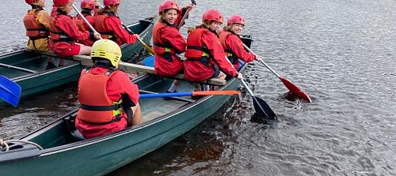
Kayaking at the Anderton Centre

