Slide 2
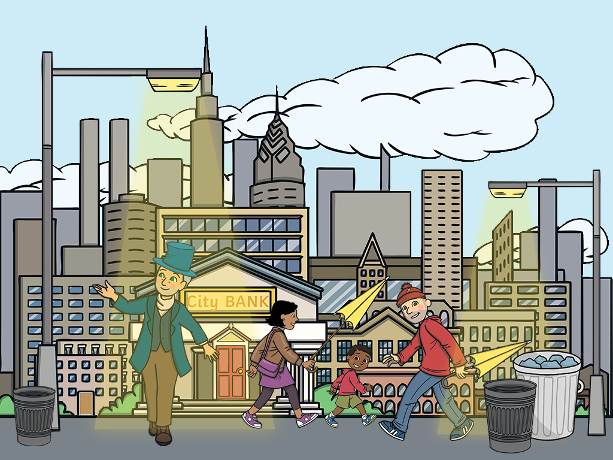
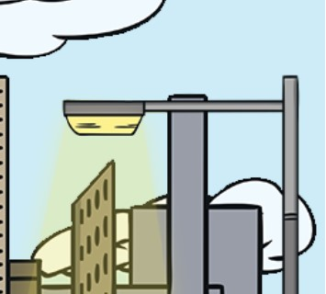
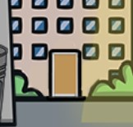
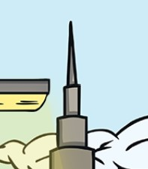
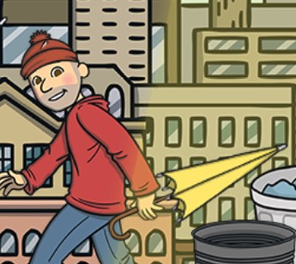
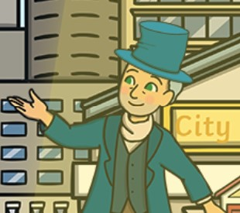
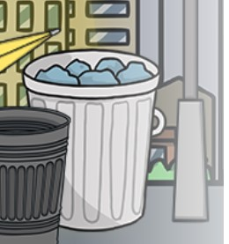
Can you find these things in the picture?
person with the shortest umbrella
tallest building
man with the tallest hat
shortest door
tall bin
short lampost
tallest person

Slide 3
Questions
What other tall things might you see in a town?
Why are traffic lights so tall?
Walk around your classroom, reaching up high and making yourself as tall as you can.
Try crouching down and making yourself very short. How does it feel?
What would you see if you climbed to the top floor of a tall building and looked out of the window?
What is the shortest thing you can find in your classroom?

