Slide 1
Roman Numerals- Friday 8th January 2021

Slide 2
Maths Warm-Up!
Fluent in 5

Slide 3
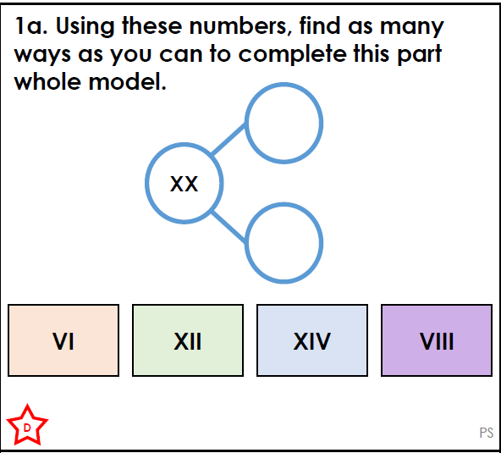

Slide 4
Developing
1a. VI and XIV
XII and VIII

Slide 5
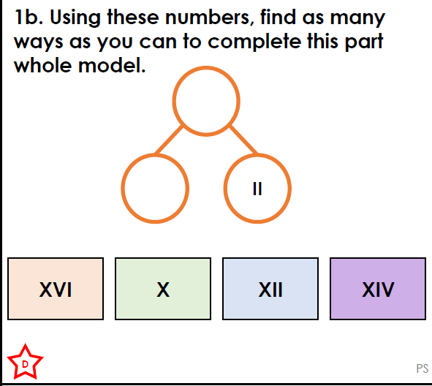

Slide 6
1b. XII and XIV
XIV and XVI
X and XII

Slide 7
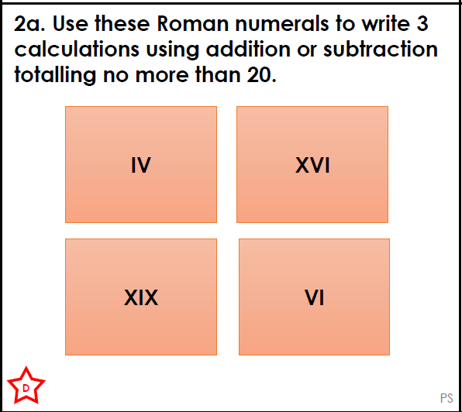

Slide 8
Various answers, for example:
IV + XVI = XX; IV + VI = X

Slide 9
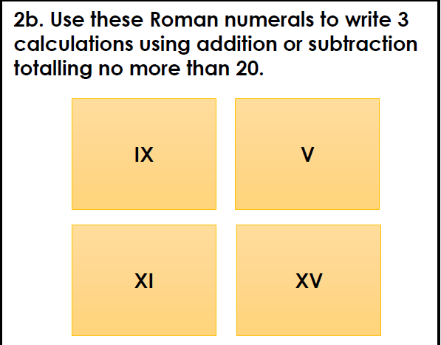

Slide 10
Various answers, for example:
X + V = XV; IX + V = XIV

Slide 11
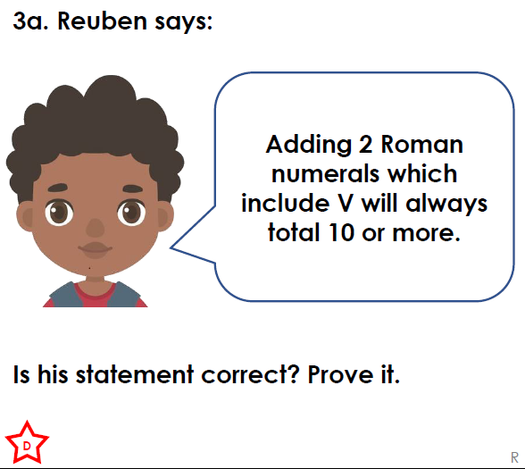

Slide 12
No because if you had: IV (4) + V(5) = IX (9)

Slide 13
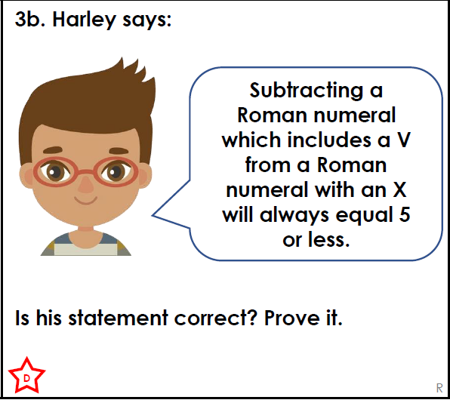

Slide 14
3b.
No because If you had: XII(12) V(5)
= 7 or X(10) IV(4) = IX(9)

Slide 15
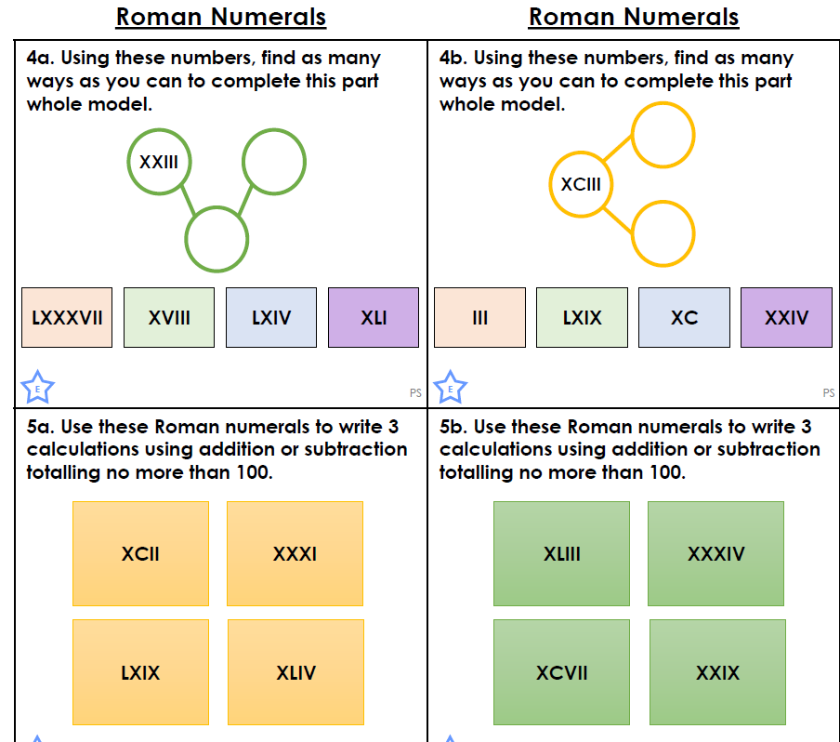
Today’s tasks on website

