Slide 1


Progression in Mastery
Year 5 Roman Numerals to 1,000
Are you ready for the challenge of Roman numerals?
©Deepening Understanding LTD 2019

Slide 2
Roman Numerals consist of 7 Letters
Roman Numerals | Number
I | 1
V | 5
X | 10
L | 50
C | 100
D | 500
M | 1000
They can be written as capital (XXII) or lower case (xxii) letters.

Slide 3
Let’s do this!
Spot the Mistakes!
How should the numbers be written in Roman numerals?
15 | 26 | 77 | 100
XIIIII | XXIV | LXXLXX | H
©Deepening Understanding LTD 2019

Slide 4


Let’s revisit what we should know…
The rule for writing Roman numerals is …..
‘There will be no more than 3 symbols used consecutively in any number’
So 4 is written as IV
Which means 1 less than 5.
90 is written as XC
Which means 10 less than 100
©Deepening Understanding LTD 2019

Slide 5
Let’s revisit what we should know..
The first 10 Roman numerals are written like this.
What single digit number cannot be written in Roman numerals?
1 | I | 6 | VI
2 | II | 7 | VII
3 | III | 8 | VIII
4 | IV | 9 | IX
5 | V | 10 | X
©Deepening Understanding LTD 2019

Slide 6
Let’s revisit what we should know..
The multiples of 10 in Roman numerals are written like this.
Can you spot any patterns?
10 | X | 60 | LX
20 | XX | 70 | LXX
30 | XXX | 80 | LXXX
40 | XL | 90 | XC
50 | L | 100 | C
©Deepening Understanding LTD 2019

Slide 7
Let’s talk
There are only 2 more Roman numerals to learn and then any number can be written!
D = 500 and M = 1,000
How do you think 400 is written?
What about 900?
©Deepening Understanding LTD 2019

Slide 8
Let’s learn
400 is written CD
Which is 100 less than 500.
900 is written CM
Which is 100 less than 1,000.
Write these numbers in Roman numerals.
425
956
425
942
©Deepening Understanding LTD 2019

Slide 9
Let’s develop our learning
We can calculate with Roman numerals!
Add 10 to each of these numbers.
Now, subtract 100 from your new number
CXCIX
DXXXVII
CCIX
DXLVII
CIX
CDXLVII
©Deepening Understanding LTD 2019

Slide 10
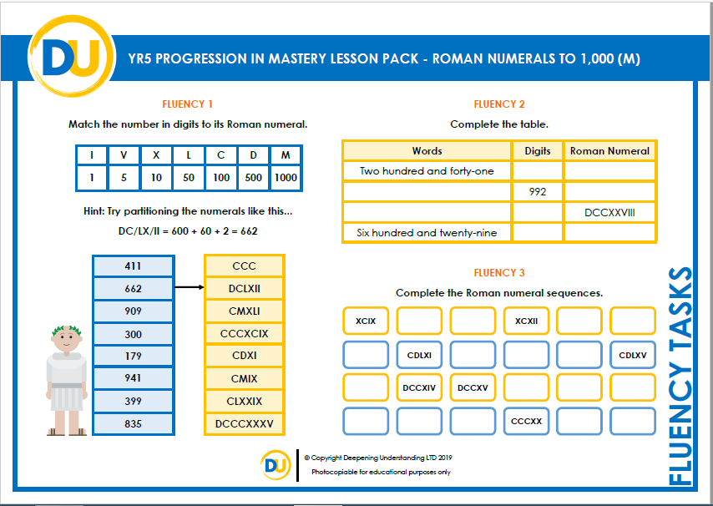
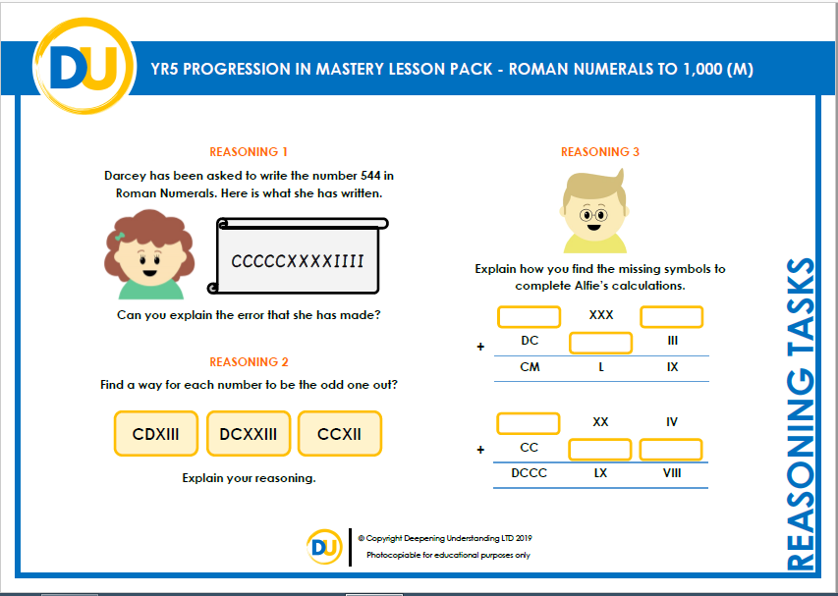
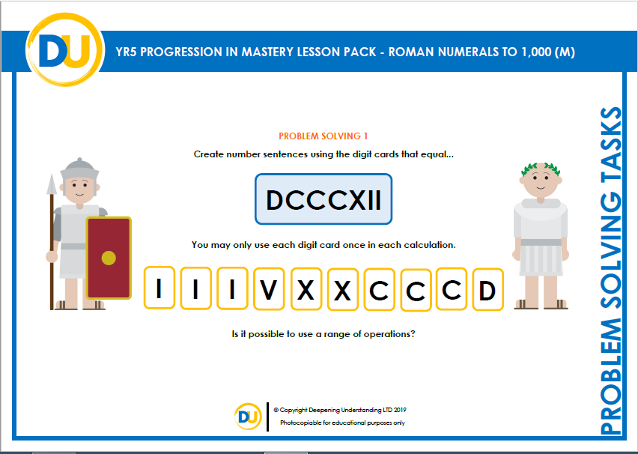
Independent Task
Let’s showcase our learning
©Deepening Understanding LTD 2019

Slide 11
Exit task – Dong Nao Jin
Use these Roman numerals once and any operation to get as close as possible to the target number.
DCLXXXV
XI
C
II
V
VIII
©Deepening Understanding LTD 2019

