Slide 1

L.O: To identify the features of a non-chronological report.
Non-chronological reports
Does anyone know what a non-chronological report is?

Slide 2

Purpose:
Non-chronological reports don’t have to be read in any order.
Aim to give us information on a topic.
Written to give other people information.
Useful for studying things we don’t know a lot about.
Written in paragraphs.
Contain an introduction, main body and final paragraph.
Reports contain specific features.

Slide 3
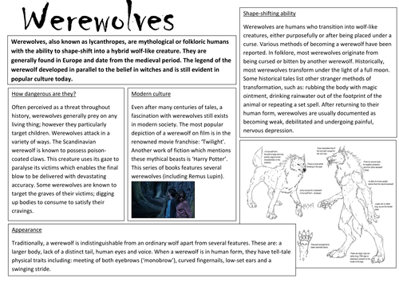
What do you think the features are?
Introduction
Look at the following example of a non-chronological report.
In your groups, do you think you know what the features used might be? Try to identify them.
Present Tense & Third person
Sub-headings
Main information
Pictures/Diagrams
Notes:
Children look at the image and try to identify the features of a non-chronological report.

Slide 4
Features of a non-chronological report:
Introduction -
What is the report about?
Sub-headings -
Separate your information.
Main information -
Facts about your topic.
Present Tense -
Imagine it is happening now.
Third Person -
Use he, she, it, etc.
Pictures/Diagrams-
What does it look like?

