Slide 1



How to learn homophones
Homophones are words that sound the same but have different spellings and different meanings, for example:
Meat Meet
These words are called homophones from the Greek words same and sound. Some other examples:
die / dye flair / flare hole / whole threw / through
Sometimes it is hard to remember which spelling to use because
Both words look right - they are both real words.
Both words sound the same - so the sounds won't help you.
So how can you remember which word is which? Try inventing a mnemonic to help fix the correct word in your memory. For example:

Slide 2
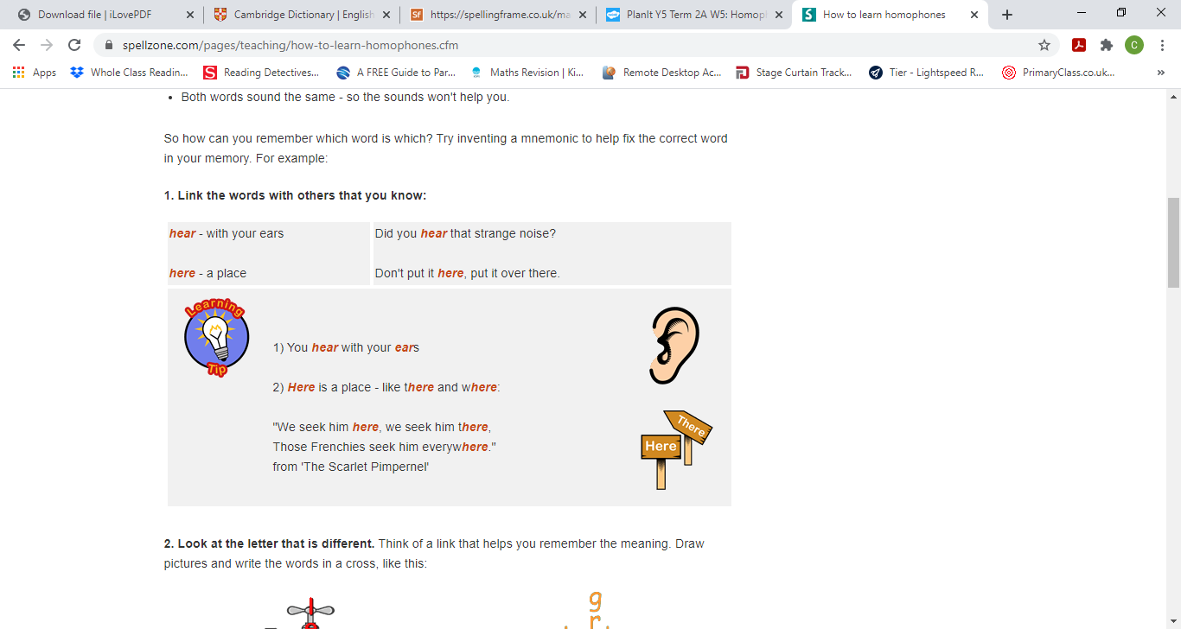
1. Link the words with others that you know:

Slide 3
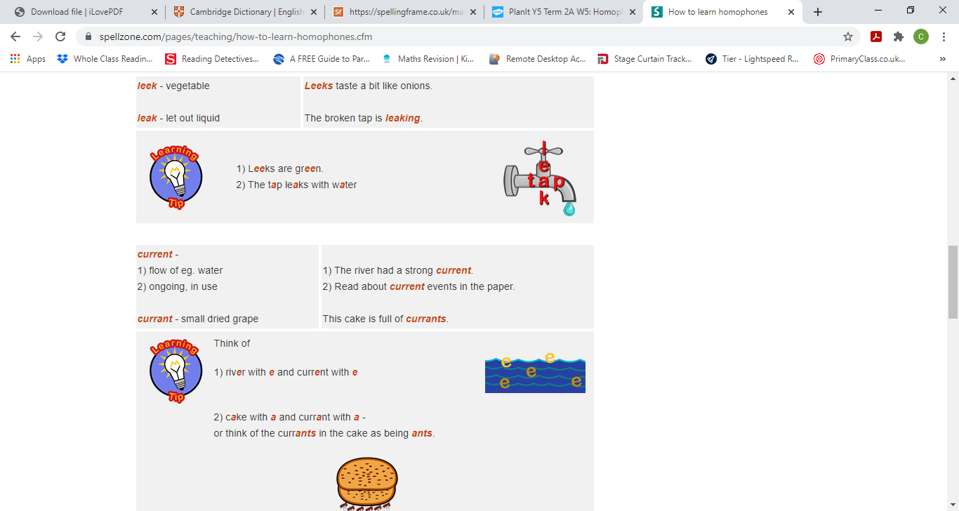
2. Look at the letter that is different. Think of a link that helps you remember the meaning. Draw pictures and write the words in a cross, like this:

Slide 4
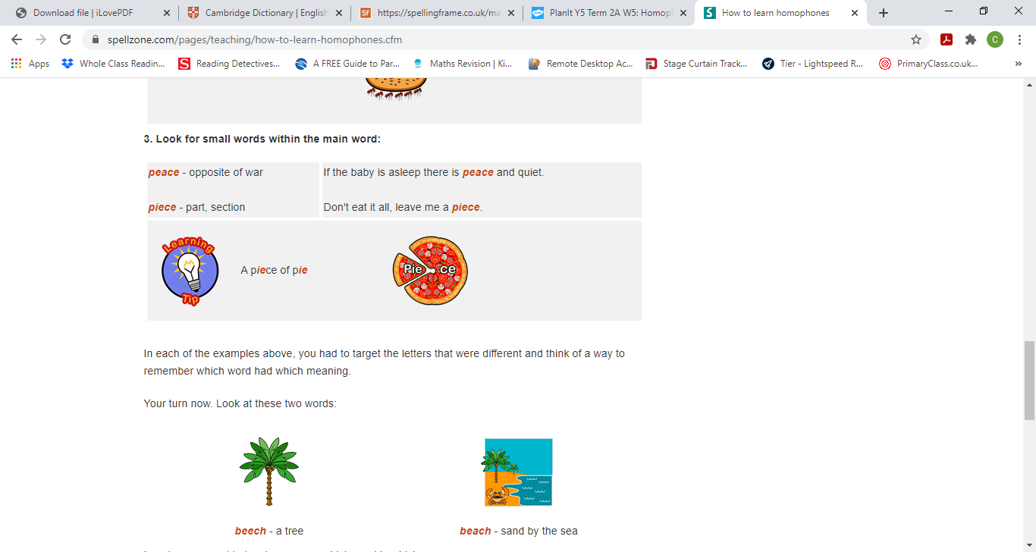
3. Look for small words within the main word:

Slide 5


