Slide 1


Slide 3
181
362 ÷ 2 =
1
8
1
2
3
1
6
2
How many 2’s are there in 16?
How many are left over?
How many 2s are there in 2?
How many 2s are there in 3?
Great!
How many are left over?

Slide 4
304
608 ÷ 2 =
3
0
4
2
6
0
8
How many 2s are there in 6?
How many 2’s are there in 0?
How many 2s are there in 8?
How many are left over?
Great!
How many are left over?

Slide 5
214
642 ÷ 3 =
2
1
4
3
6
4
1
2
How many 3s are there in 12?
How many 3’s are there in 4?
How many 3s are there in 6?
How many are left over?
Great!
How many are left over?

Slide 6
128
512 ÷ 4 =
1
2
8
4
5
1
1
3
2
How many 4’s are there in 11?
How many 4s are there in 32?
How many are left over?
How many 4s are there in 5?
Great!
How many are left over?

Slide 8
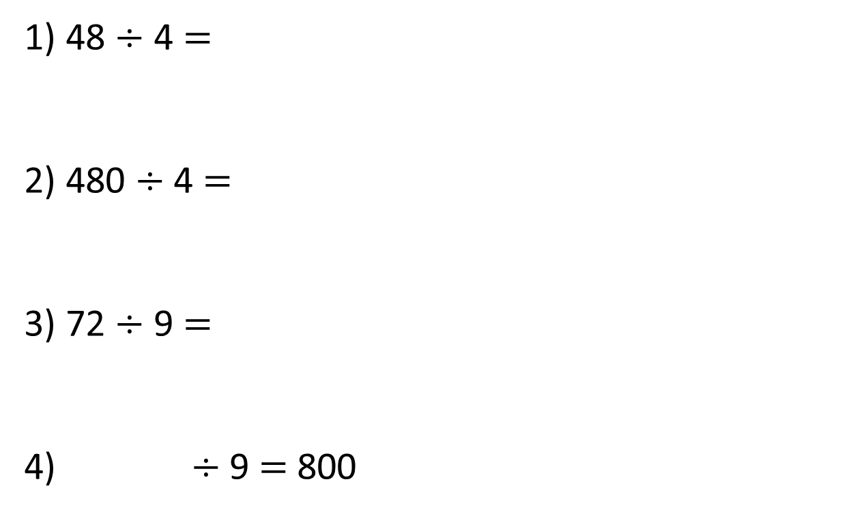
1) 48 $÷$ 4 $=$
2) 480 $÷$ 4 $=$
3) 72 $÷$ 9 $=$
4) $÷$ 9 $=$ 800

Slide 9
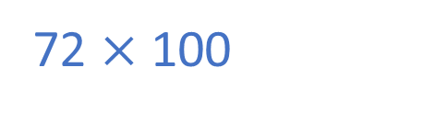
12
1) 48 $÷$ 4 $=$
2) 480 $÷$ 4 $=$
3) 72 $÷$ 9 $=$
4) $÷$ 9 $=$ 800
120
8
7,200
72 $×$ 100

Slide 11

There are 4,884 crayons and they come
in packs of 4
How many packs are there?

Slide 12




There are 4,884 crayons and they come
in packs of 4
How many packs are there?
1,221 packs
Thousands | Hundreds | Tens | Ones
4 | 4 | 8 | 8 | 4
1
2
2
1

Slide 13


9,306 $÷$ 3
Have a think
Thousands | Hundreds | Tens | Ones
3 | 9 | 3 | 0 | 6
3
1
0
2

Slide 14

4,324 $÷$ 2
Thousands | Hundreds | Tens | Ones
2 | 4 | 3 | 2 | 4
2
1
6
2
1

Slide 15

Have a think
6,115 $÷$ 5
Thousands | Hundreds | Tens | Ones
5 | 6 | 1 | 1 | 5
1
2
2
3
1
1
1

Slide 16
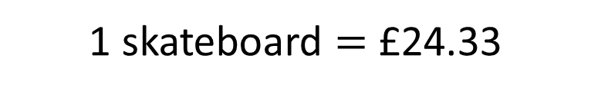
3 skateboards cost £72.99
How much does one cost?
.
3 | 7 | 2 | 9 | 9
2
4
.
3
3
1
1 skateboard $=$ £24.33

Slide 17
 | 9 | 4 | 2
3
1
4
3
3
1
9
Thousands | Hundreds | Tens | Ones

