Slide 1


Slide 3
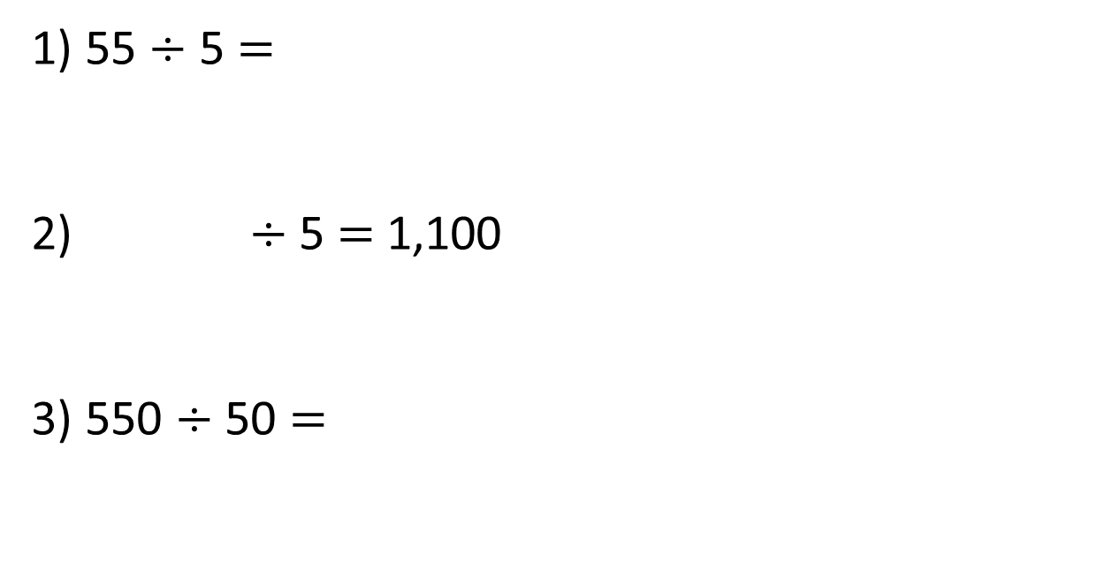
1) 55 $÷$ 5 $=$
2) $÷$ 5 $=$ 1,100
3) 550 $÷$ 50 $=$

Slide 4
1) 55 $÷$ 5 $=$
2) $÷$ 5 $=$ 1,100
3) 550 $÷$ 50 $=$
11
5,500
11

Slide 6


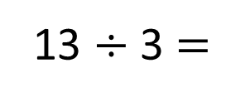
Eva has 13 straws. She wants to make them into triangles. How many triangles can she make?
13 $÷$ 3 $=$
4 r1

Slide 7




Tommy has 14 straws. He wants to make them into triangles. How many triangles can he make?
Dora has 15 straws. She wants to make them into triangles. How many triangles can she make?
Jack has 16 straws. He wants to make them into triangles. How many triangles can he make?
Have a think

Slide 8
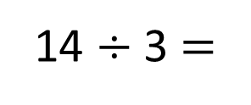
Tommy has 14 straws. He wants to make them into triangles. How many triangles can he make?
14 $÷$ 3 $=$
4 r2

Slide 9
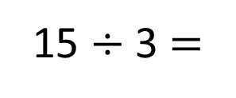
Dora has 15 straws. She wants to make them into triangles. How many triangles can she make?
15 $÷$ 3 $=$
5

Slide 10
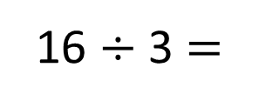
Jack has 16 straws. He wants to make them into triangles. How many triangles can he make?
16 $÷$ 3 $=$
5 r1

Slide 11
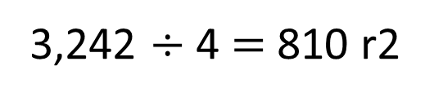
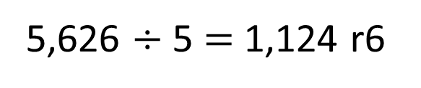
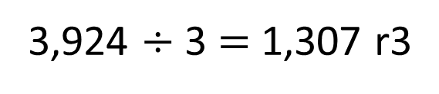
Have a think
Could these calculations be correct?
3,924 $÷$ 3 $=$ 1,307 r3
3,242 $÷$ 4 $=$ 810 r2
5,626 $÷$ 5 $=$ 1,124 r6
Could be correct | Definitely incorrect

Slide 12





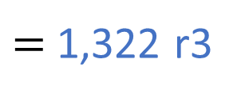
5,291 $÷$ 4
$=$ 1,322 r3
Thousands | Hundreds | Tens | Ones
4 | 5 | 2 | 9 | 1
1
3
2
2
r3
1
1

Slide 13

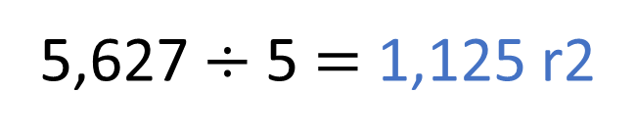
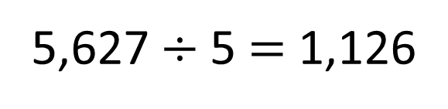
Have a think
5,627 $÷$5 $=$ 1,126
The 5 times table is in a pattern: 5, 10, 15, 20 ..
5,627 is a whole number but it doesn’t end in a 5 or a 0 so the answer must have a remainder.
5,627 $÷$5 $=$ 1,125 r2

Slide 14
There are 349 people at a wedding. They are sitting at tables in groups of 8
How many tables are needed?
8 | 3 | 4 | 9
0
4
3
r5
3
2
We need 44 tables.
We need 43 tables.
Have a think

Slide 15
Have a go at the rest of the worksheet

