Slide 1

https://www.childrensmentalhealthweek.org.uk/

Slide 2
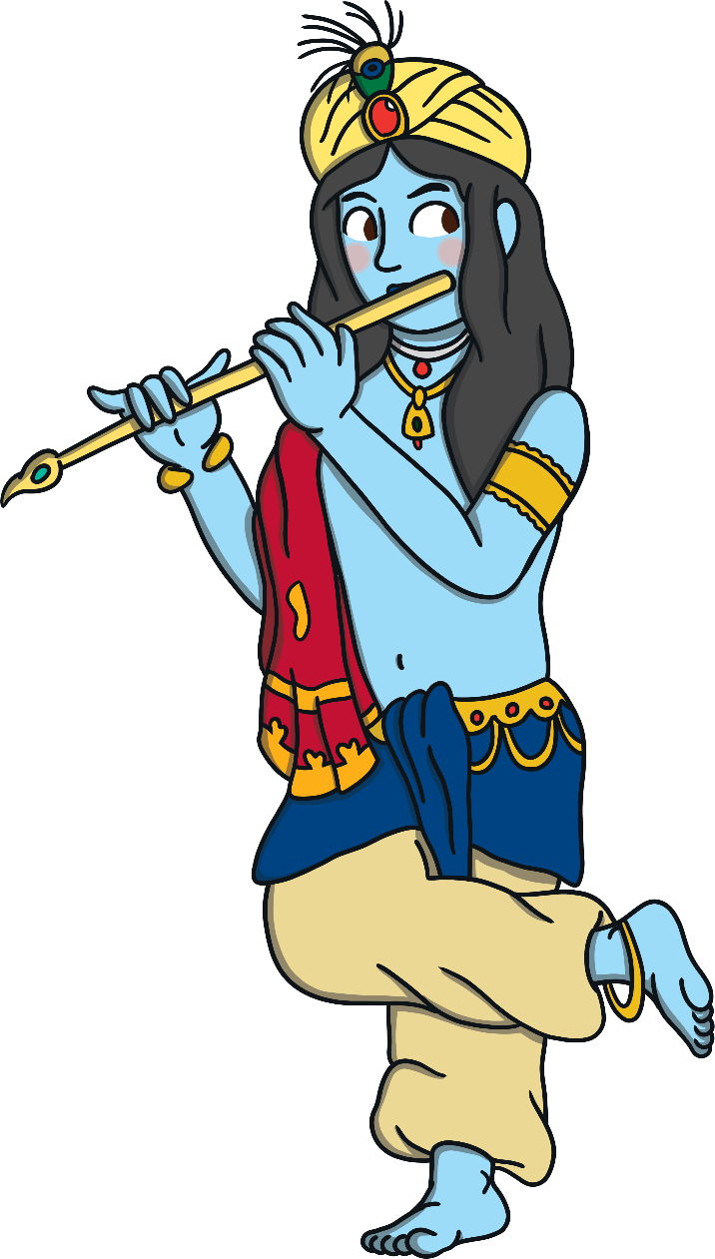
Krishna
Krishna is one of the most popular Hindu gods. He is the eighth incarnation of the Hindu god Vishnu but he is also a god in his own right. In fact, he is the most worshipped of all.
He is the god of love and devotion and he is the most famous of all the heroes of Hindu mythology.

Slide 3
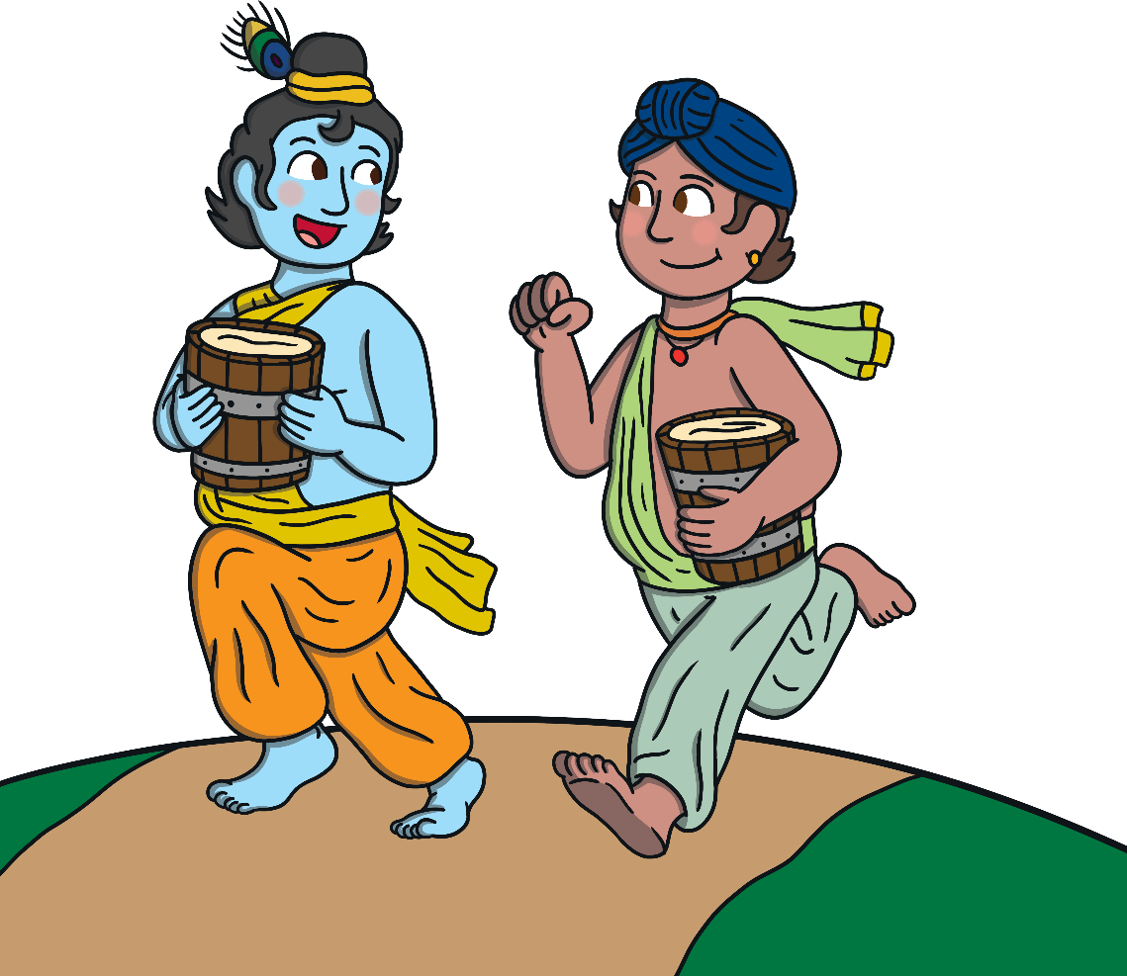
Childhood
Many children are told stories about Krishna’s childhood. As a child, Krishna liked to play mischievous pranks.
Krishna, his brother Balarama and his friends all loved butter. They would trick their mothers, the gopis, so they could get to the pots of butter that had been hung up high. They would lift tiles off the roof and even make human ladders to get to them!

Slide 4

The Sound of Krishna’s Flute
As a young man, Krishna was a cowherd. His job was to take the cows from field to field for grazing.
As he worked, he used to play the flute. The sound of his flute was so beautiful that the young gopis from the villages where he passed would leave their homes to dance with him in the moonlight.

Slide 5
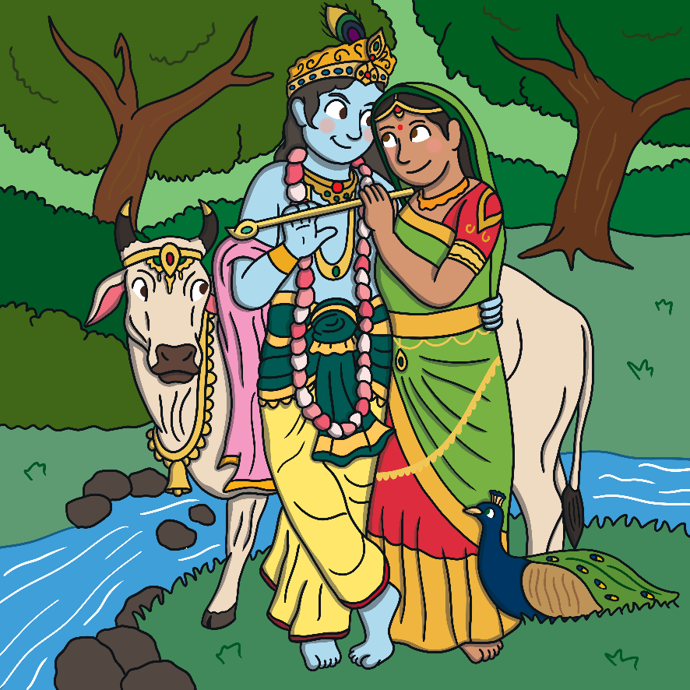
Krishna and Radha
Krishna’s favourite among the gopis was the beautiful Radha.
Krishna and Radha are often shown together.
Have a look at this picture.
What symbols can you see?
The cow represents the fact that Krishna was a cowherd.
The crowns on Krishna and the cow show that they are sacred.

Slide 6

The Peacock Feather
Another important symbol linked with Krishna is the peacock feather. He always wears one on his head.
Peacock feathers have an ‘eye’ in them. The ‘eye’ on Krishna’s peacock feather represents the third eye or sixth sense.
The third eye is a special connection with the gods.

Slide 7

Hare Krishna Movement
The International Society for Krishna Consciousness (ISKCON), better known as Hare Krishna movement or Hare Krishnas, is a religious movement. People who are part of the Hare Krishna movement wear bright orange clothes and have their heads shaved.
They have a special chant that goes like this:
Hare Krishna, Hare Krishna
Krishna Krishna, Hare Hare
Hare Rama, Hare Rama
Rama Rama, Hare Hare

Slide 8
Glossary
cowherd – A person whose job is to herd cattle.
incarnation – A god in human form.
gopi – A person who works with the cows, milking and making dairy products.
graze – To eat grass in a field.
mischievous prank – Naughty tricks played without nastiness, simply to make people laugh.
mythology – The collection of stories (myths) often describing the adventures of beings with super human powers that explains a religious belief or practice.
sacred – Something is seen as being linked to a religion and given great respect.
symbol – An object or action that stands for something or has meaning.
worship – To show a lot of love and adoration for something.

Slide 9
Link to video…
https://www.bbc.co.uk/bitesize/clips/znmpvcw

Slide 10
Today’s Task
We are going to re-tell the story of “Krishna and the Butter”. We are going to imagine that we are telling the story to someone in Key Stage 1. We need to explain the story concisely and in a fun way to engage the younger children ☺. If you want to, you could even post a video of yourself telling the story!
There is a help sheet on our website to use so that you can remember the steps. Re-watching the BBC video will also help. Have fun!

