Slide 1
Holi
A Hindu Festival of colours
HOH-LI

Slide 2
What is Holi?
Holi is a Hindu festival held in the spring celebrated mostly in India, but also in many places around the world.
It’s a time when people remember how good triumphed over evil.
It takes place in March or April. This year it is the 28th- 29th March.

Slide 3
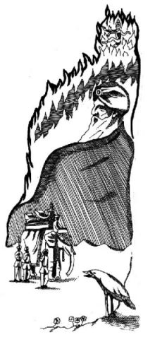

The story of Holi
A long time ago, in India, there was a king called Hiranyakashup who had a son called Prahlad.
The king wanted everyone to think of him as God and to worship him. As Prahlad grew up he realised that this was not true and refused to worship his father. He worshipped Vishnu, a real God.

Slide 4

Hiranyakashup was very angry and punished his son. However Prahlad still refused to worship him and so the king decided that his son must die. The king tried many different ways to kill Prahlad.

Slide 5

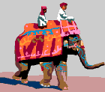
He was put in a pit full of snakes, he was beaten by soldiers and he was trampled by elephants, but each time he prayed to Vishnu and he was saved.

Slide 6


The king’s sister, Holika, agreed to help the king. She was thought to have magical powers which made her fireproof. Holika took Prahlad to the top of a bonfire and the bonfire was lit. Holika expected Prahlad to die. Instead, it was Holika who died and again Prahlad was saved.

Slide 7
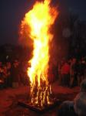
Prahlad felt sorry for Holika and promised to name the festival after her.
Every year, at the time of Holi, Hindus light bonfires to remind them of this time when good triumphed over evil.

Slide 8
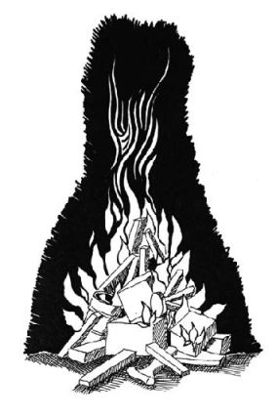
How do Hindus celebrate Holi?
Last year’s rubbish is burned so that people can make new beginnings.
Festival processions and dancing take place.

Slide 9
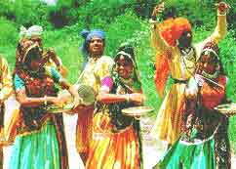
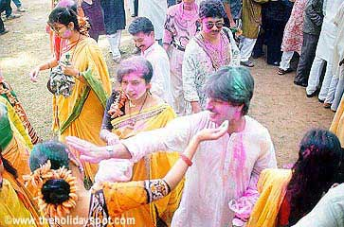

Festival processions and dancing take place.

Slide 10
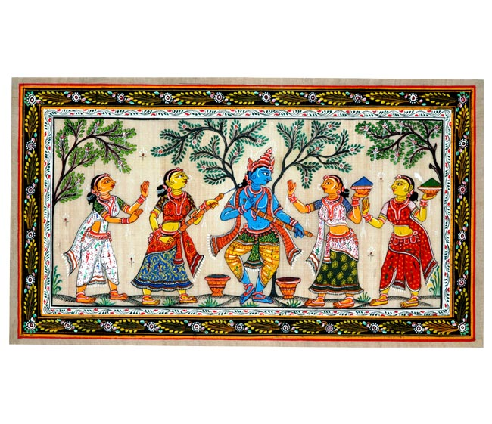
Hindus also celebrate another story about a boy called Krishna. He used to play tricks on maids like throwing paint at them.

Slide 11
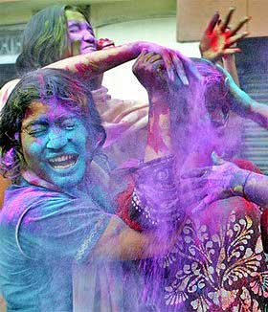
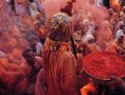
People throw coloured water or paint at passers by.
People are allowed to be rude to those they normally respect. For instance, pupils may throw things at teachers!!!

Slide 12
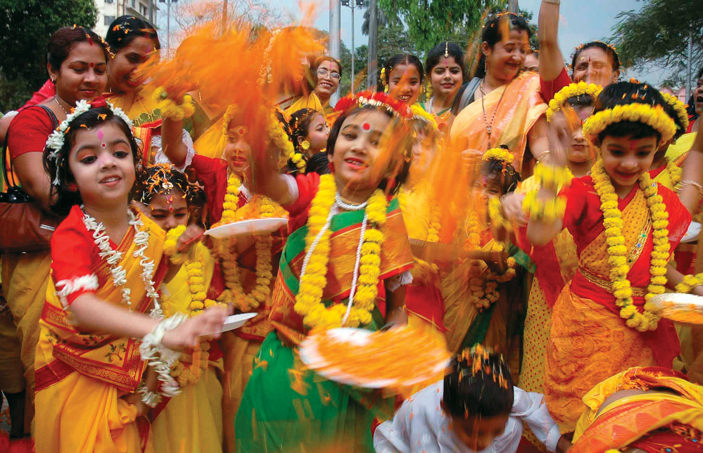
Children celebrating Holi

Slide 13
More Information
https://www.bbc.co.uk/bitesize/topics/zh86n39/articles/z4qqy9q

Slide 14
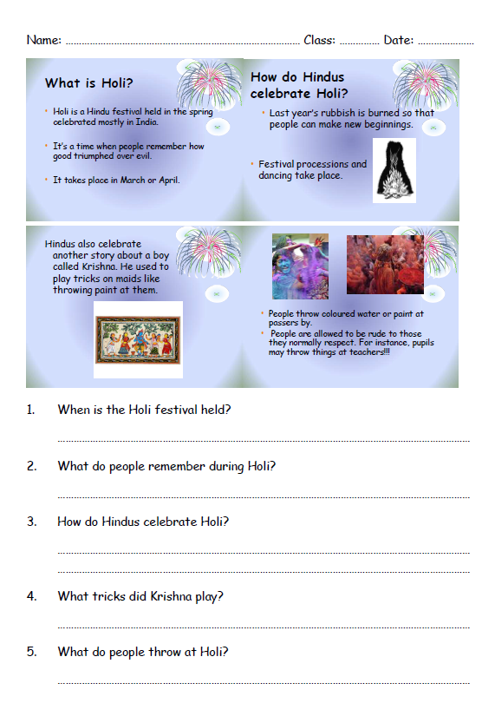
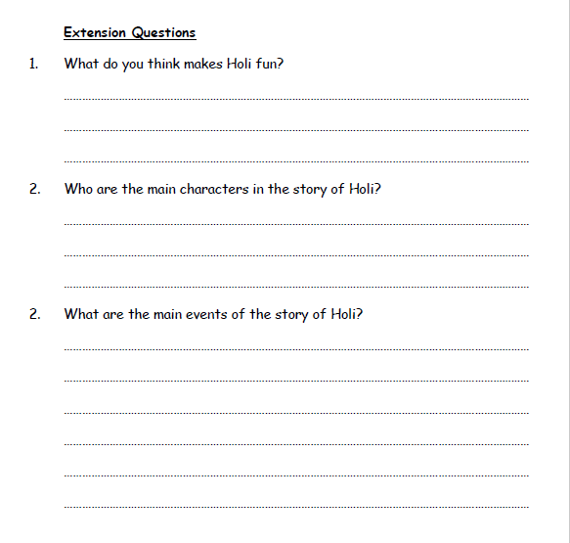
Today’s Tasks

