Slide 1

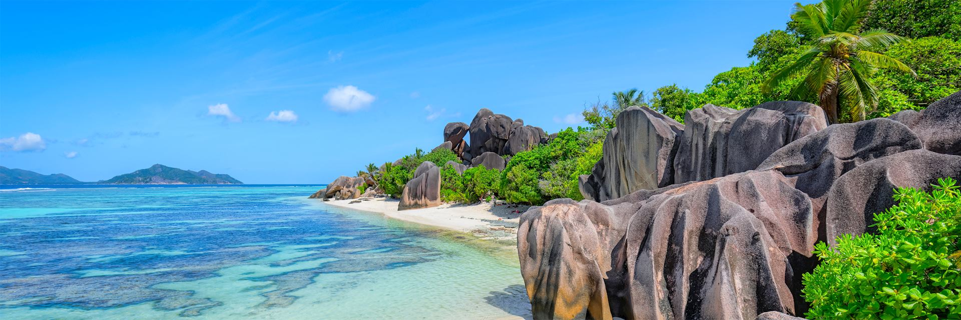
TRAVEL GUIDES

Slide 2
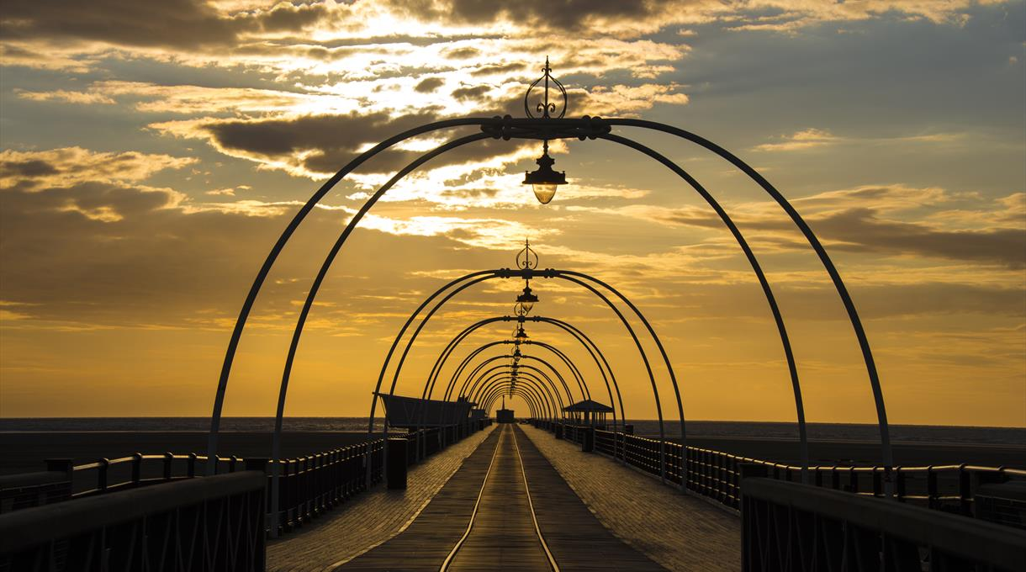
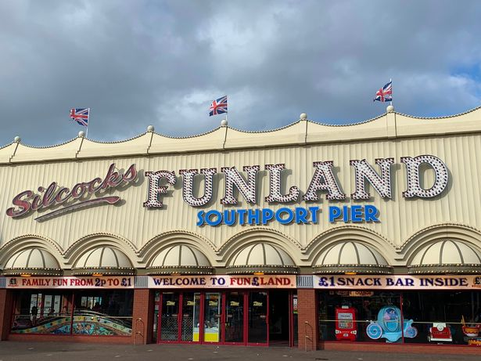
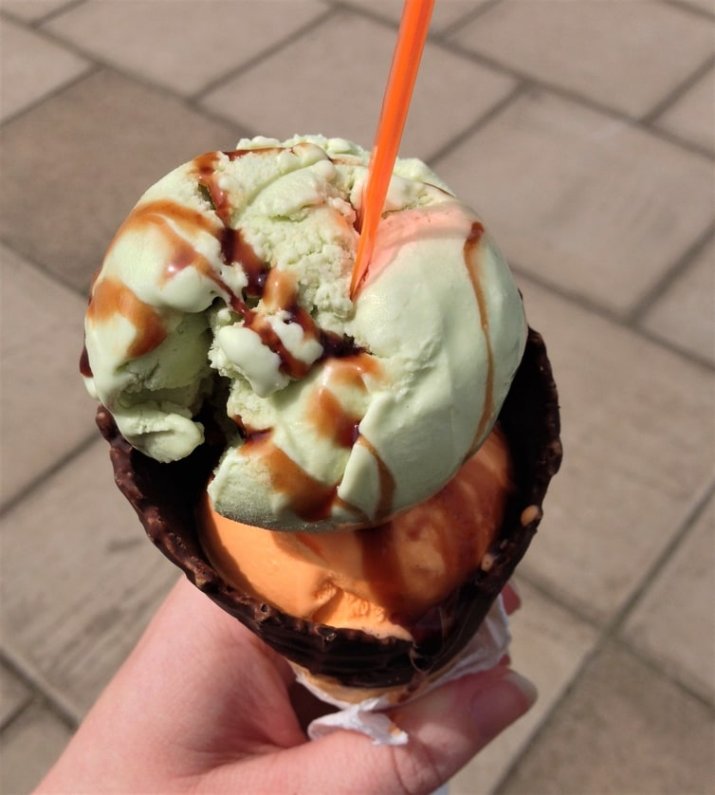
sOUTHPORT
https://www.visitsouthport.com/

Slide 3
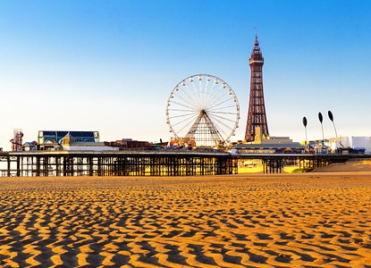
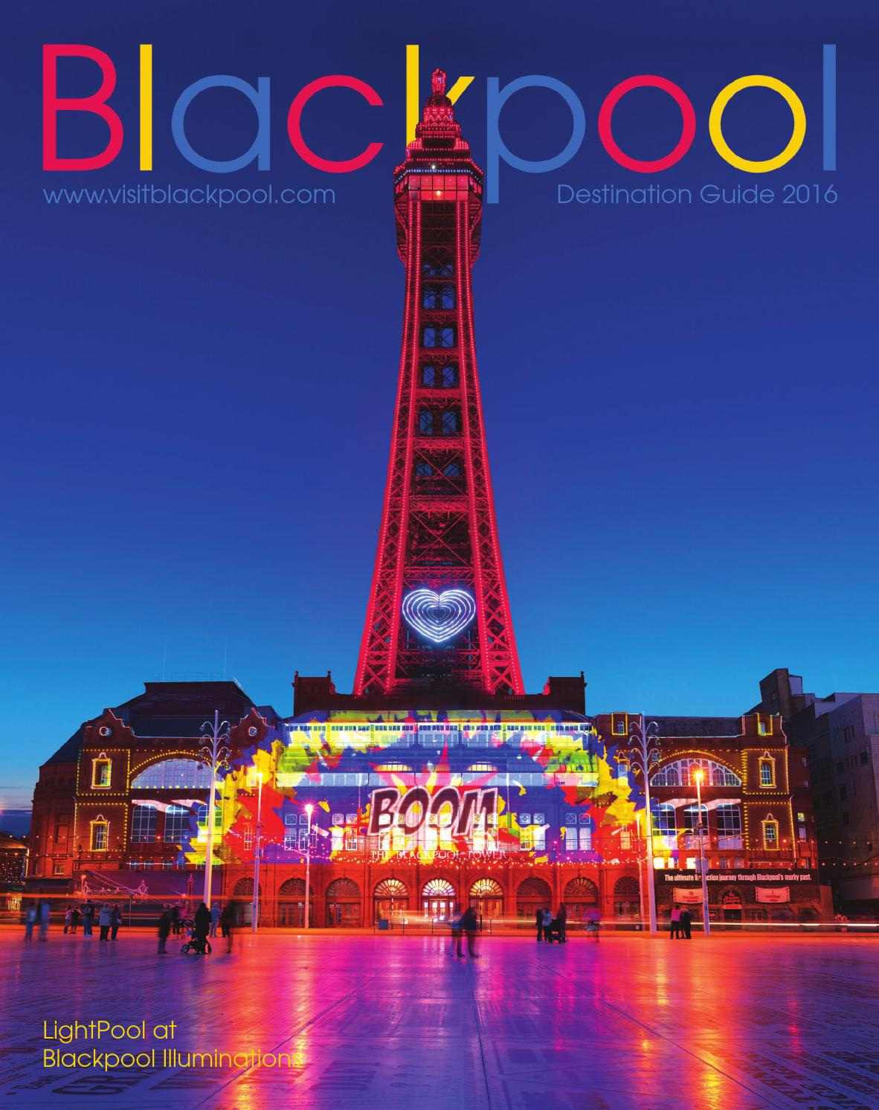
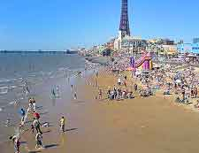
bLACKPOOL
https://www.visitblackpool.com/

Slide 4
https://www.roughguides.com/special-features/britains-30-best-seaside-towns/

Slide 5
Today’s task
Today we are going to write a travel guide for our own ‘made-up’ coastal town! It has to be in Britain. It has to resemble a ‘real’ coastal town such as Blackpool or Southport. By this, I mean it will have similar features such as amusements, a fairground, a beach and local amenities. Let’s look at an example:

Slide 6
Example

