Slide 1
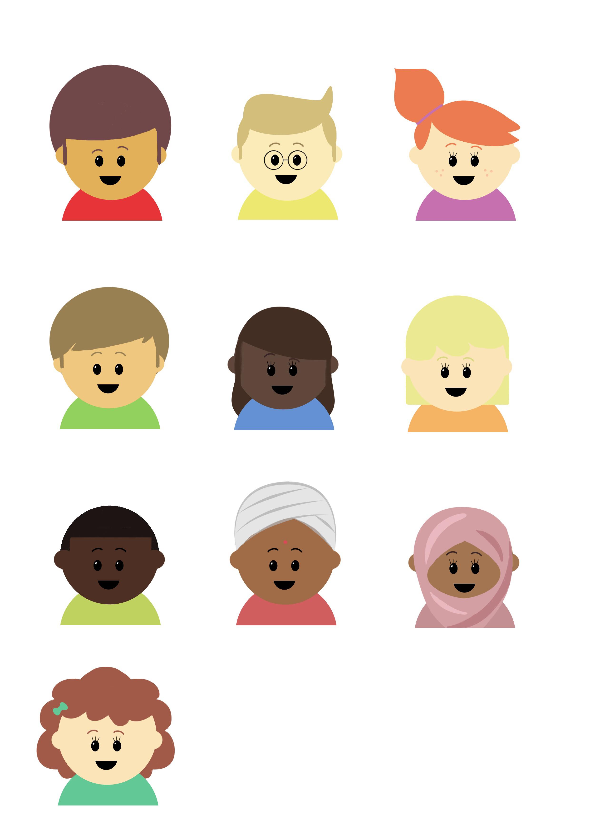

Wonder of Well-being
UKS2 – Anxiety Triggers
Let’s talk about what makes us anxious
©Deepening Understanding LTD 2020

Slide 2
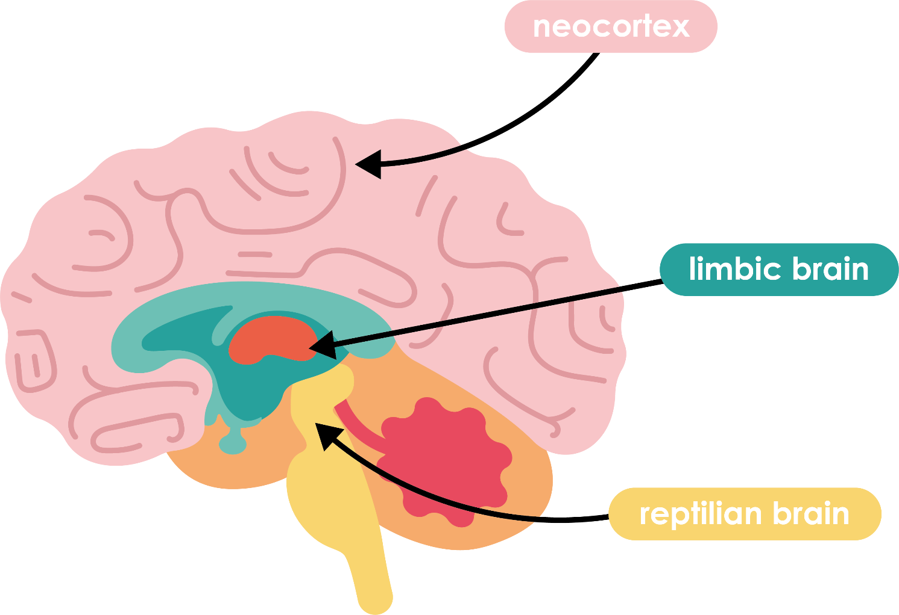
Let’s understand
Last session, we talked about how the brain needs to feel calm and safe for you to be able to learn.
reptilian - The primitive part of the human brain that mirrors that of reptiles, controlling instinctive behavior.
In order to learn successfully, the reptilian brain must not be scared; it must feel safe and calm.
©Deepening Understanding LTD 2020

Slide 3
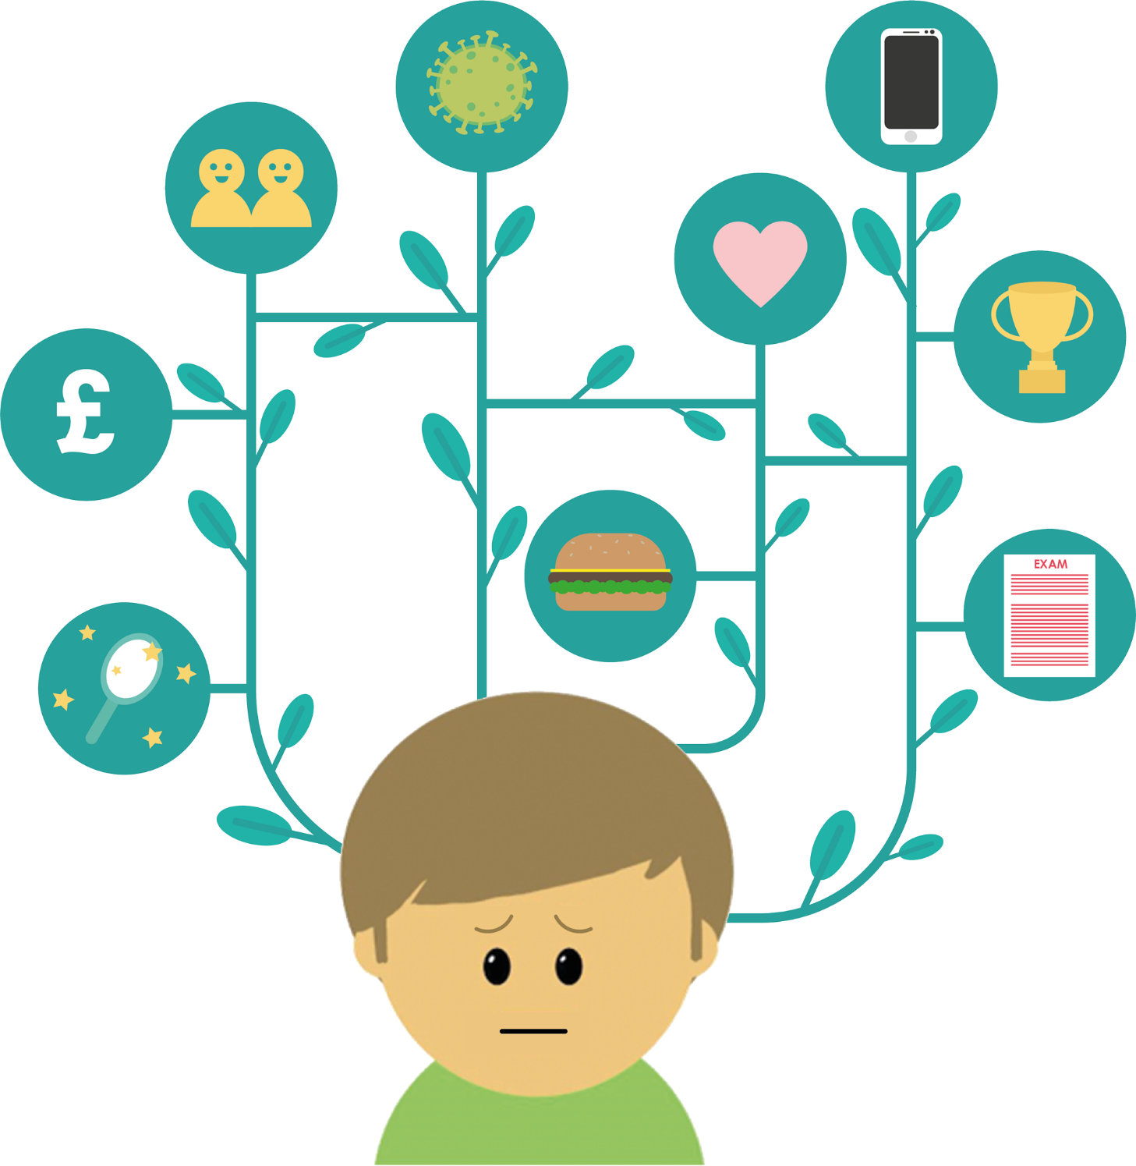

Let’s ponder
When things make you anxious or upset, we call them ‘triggers’
Think of things that are your ‘triggers’.
©Deepening Understanding LTD 2020

Slide 4
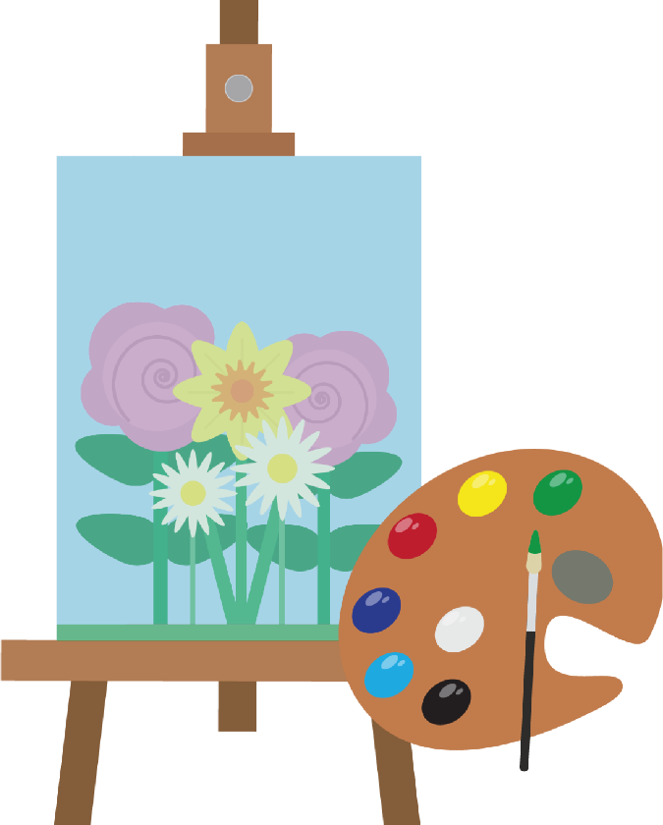

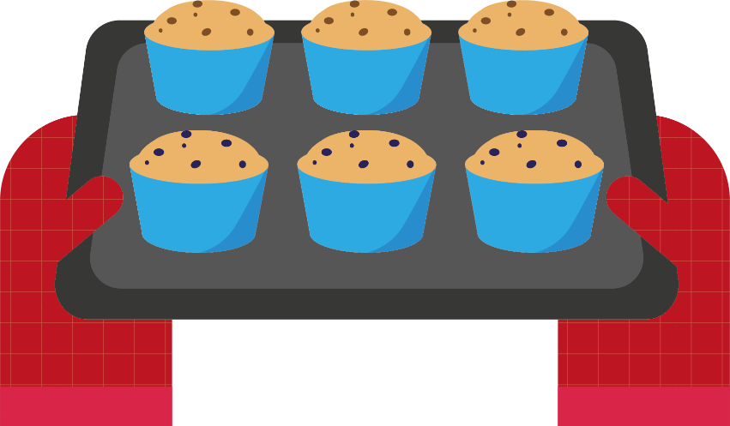

Let’s connect
Now, think about activities that make you feel calm.
©Deepening Understanding LTD 2020

Slide 5
Let’s reflect
How can you help others in your bubble if they are anxious and upset?
©Deepening Understanding LTD 2020

Slide 6
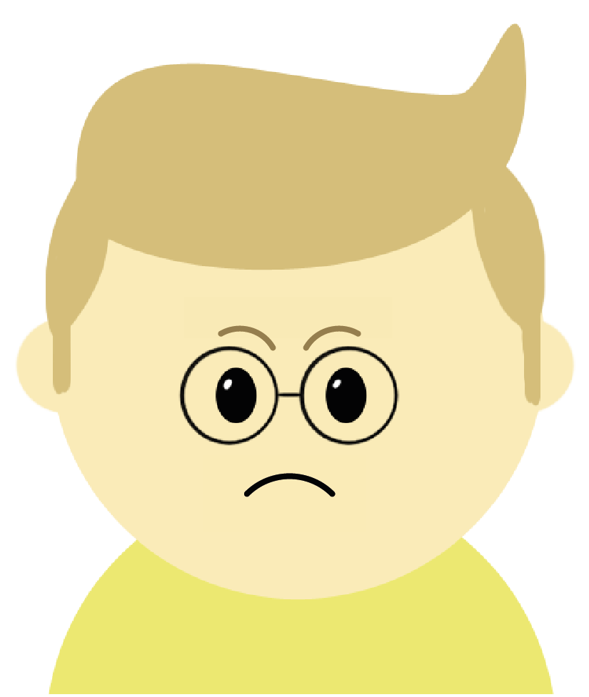
Let’s reflect
Ways that you could help include…
allowing them to talk about their worries
sharing a funny story
simply giving them a smile or thumbs-up
©Deepening Understanding LTD 2020

Slide 7


Let’s imagine
Imagine your mind as the sea or a lake.
©Deepening Understanding LTD 2020

Slide 8
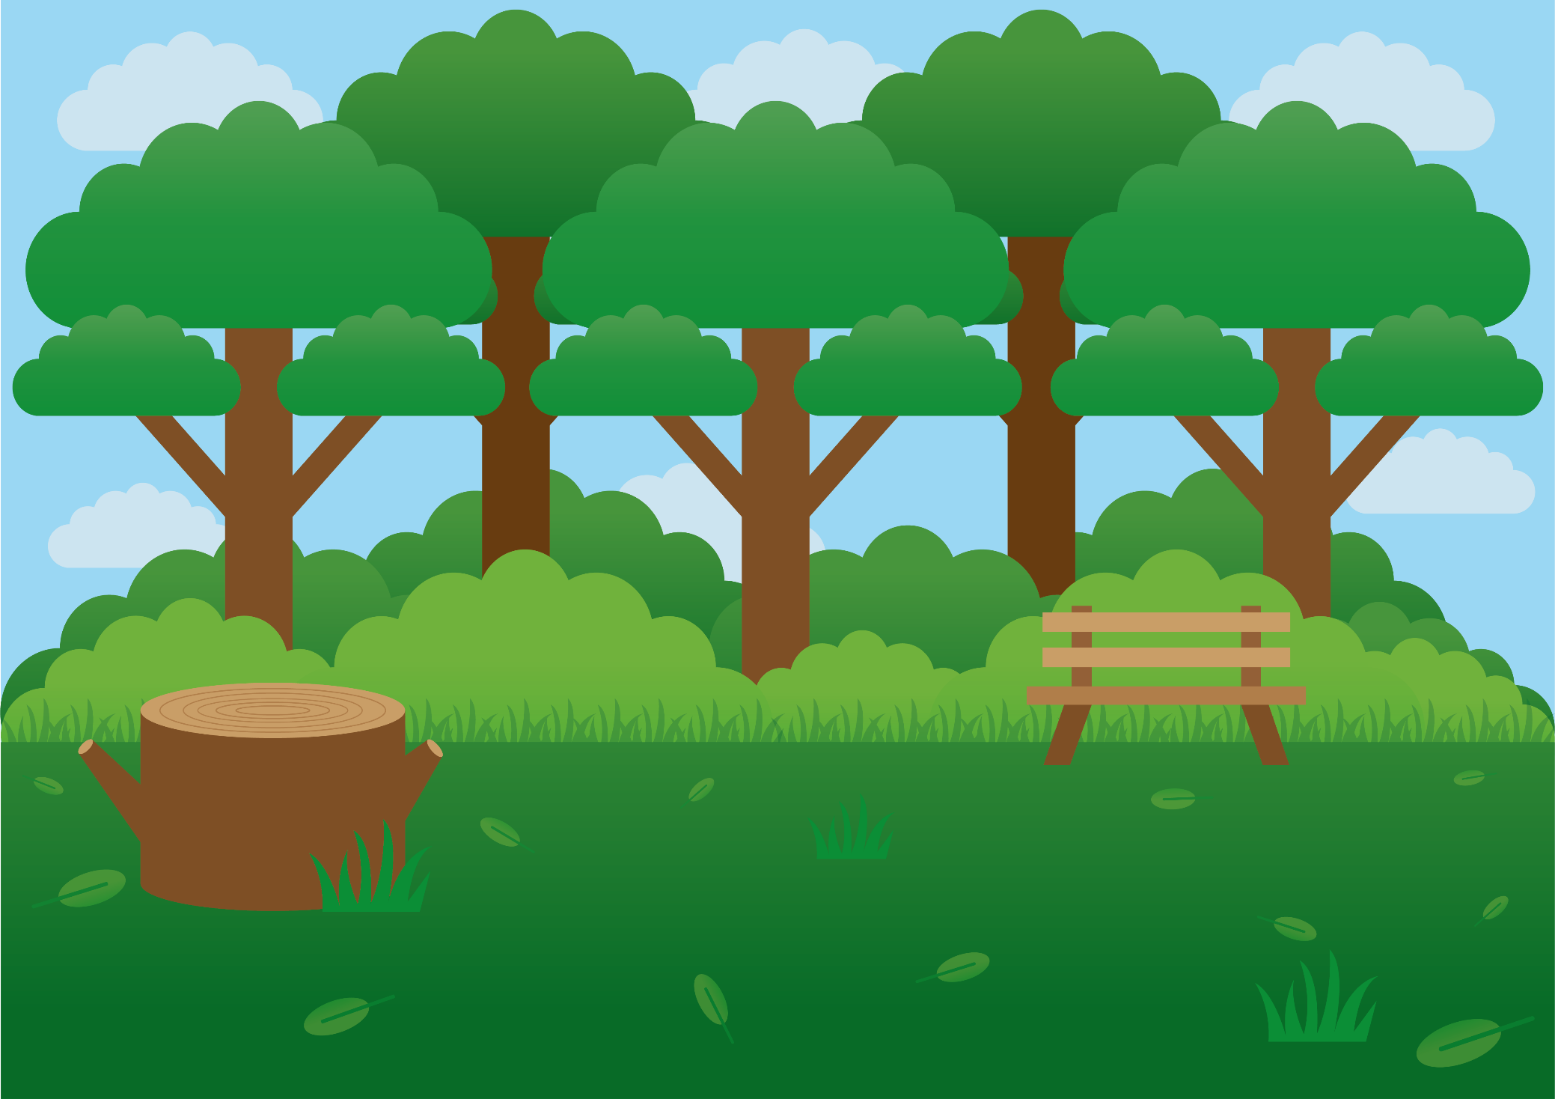
Let’s innovate
Create your own mindfulness script. Link it to nature and the senses.
©Deepening Understanding LTD 2020

