Slide 1
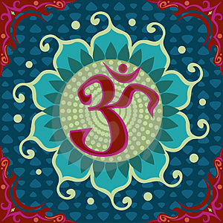
Hinduism
Notes:
http://www.coxhoe.durham.sch.uk/Curriculum/RE.htm

Slide 2
https://www.bbc.co.uk/bitesize/topics/zh86n39/articles/zmpp92p

Slide 3
Hinduism
Learning Objectives:
MUST show knowledge of gods and goddesses in Hinduism
SHOULD be able to explain differences between different gods in Hinduism
COULD identify your favourite qualities in Hindu Gods

Slide 4
Hinduism
There are three main gods in Hinduism:
Creator (Brahma)
Preserver (Vishnu)
Destroyer ( Shiva)
Notes:
http://www.primaryresources.co.uk/re/powerpoint/The_Trimurti.ppt#261,6,Aum

Slide 5
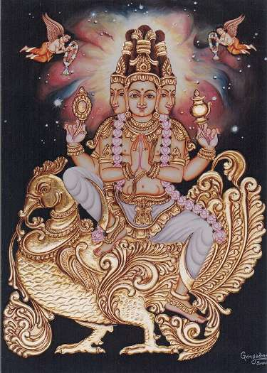
Brahman
Hinduism teaches that there is one great power. This power is Brahman. It is not a person. It is not male or female. It is the power of the universe, the power that is in everything and has caused everything to exist. Without Brahman there would be nothing. To explain this, Hindus use the example of water with salt in it. The salt in the water is everywhere just as Brahman is in everything. Hindus think of Brahman as “God.”

Slide 6
Brahman
Five things Hindus believe about Brahman:
1)
2)
3)
4)
5)
In your exercise book write down the 5 things that you have remembered!

Slide 7
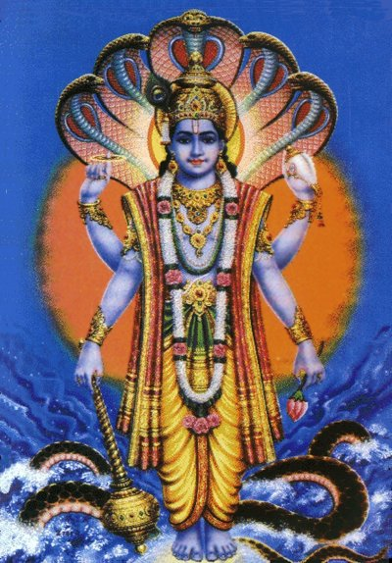
Vishnu
Hindus believe that Vishnu has come to earth nine times. Each time, he came when the earth was in danger. He came to protect it. The two most important times were when he came as the god Rama, and then as the god Krishna. Krishna is very popular for Hindus.

Slide 8
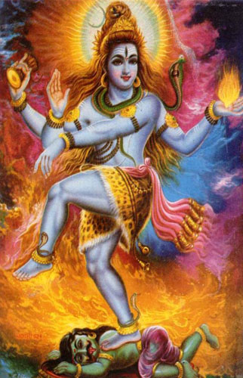
Shiva
Shiva is worshipped by about 25 per cent of all Hindus. Hindus believe that Shiva is in charge of life and death, and of good and evil. This is why statues of Shiva show him with at least four hands. He is often shown dancing, and one of his names is Lord of the Dance. Hindus believe that one of his names is the energy which keeps the universe moving.

Slide 9
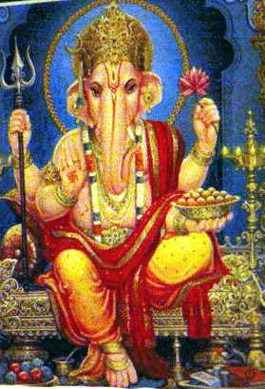
Ganesh
  Ganesh has an elephant’s head. In the family of gods, he is Shiva’s son. Hindus believe that Shiva cut off Ganesh’s head by mistake, and gave him an elephant’s head instead. For Hindus, Ganesh is the god of learning and good luck. Hindus who are beginning something new often pray to him.

Slide 11
Who is your favourite God and why?
  My favourite Hindu god is: __________
  Because: ________________________
  ________________________________
  ________________________________
  ________________________________
  ________________________________
  ________________________________
  If I could be represented I would like to
  be: ____________________________
  _______________________________
  Because ________________________
  ________________________________
  ________________________________

Slide 12
http://www.crickweb.co.uk/assets/resources/flash.php?&file=HinduJigsaw

