Slide 1
L.O. To understand and apply relative pronouns.

Slide 2
Let’s recap last lesson
What do you remember about modal verbs?
Can you give an example of how a modal verb can be used?

Slide 3
Relative pronouns
Can anyone explain what a relative pronoun is?
A relative pronoun is used to connect a clause or phrase to a noun or pronoun. You see them used every day with the most common relative pronouns being: who, whom, which, whoever, where, when, and that.

Slide 4
Identify the relative pronouns in these sentences
1. The lady, who was here to see you yesterday, called again this morning.
2. Bring me the letters that lie on the table.
3. Is this the train which leaves for New York at six o'clock?
4. The church, where the carol service was held, is always busy.
In these sentences the words who, where, that and which are called relative pronouns. They are used to explain something about the noun that goes before them.

Slide 5
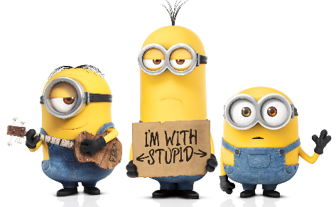
Task
Write a character description based on one of the characters I’m about to show you. Your character description needs to include at least 4 relative pronouns.

Slide 6
Can you identify the relative pronouns and explain their job in the sentences?
Stuart is a Minion of average height. His goggles, that cover his lone eye, are made of super strength metal and glass and protect his all-important vision. This Minion wears blue dungarees and stylish black gloves which match his comfortable footwear. When he wakes up in the morning, Stuart’s first thought is his hair; he hates how he can’t get it to stick up like his friend Kevin’s does. Stuart, who is the most creative and talented Minion in the group, often serenades his two friends; much to their dislike!

Slide 7
Task
Write a character description based on one of the characters I’m about to show you. Your character description needs to include at least 4 relative pronouns.

Slide 8
Question
Circle the relative pronoun in this sentence.
The birthday cake was on a plate which was decorated with flowers.

