Slide 1
VOLUME
The amount of space something takes up

Slide 2
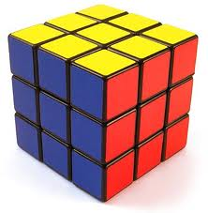
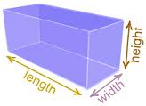
We are learning to find the volume of cuboids and cubes

Slide 3
To find the VOLUME:
Length x breadth x height = volume
L x B x H = V
Some people use:
length x width x height = volume
Or
length x depth x height = volume
They means the SAME thing!

