Slide 1
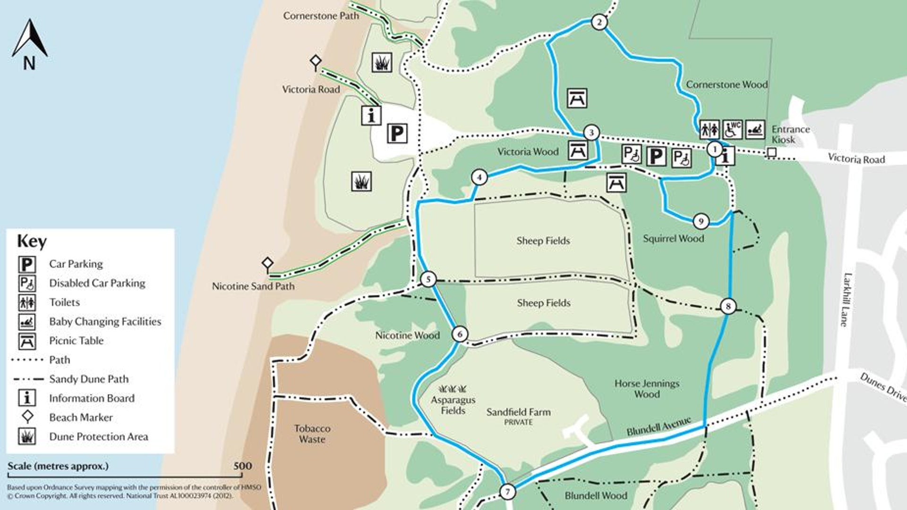
https://www.youtube.com/watch?v=HX5bZsLOjcg&safe=active

Slide 2
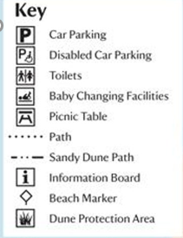

Slide 3
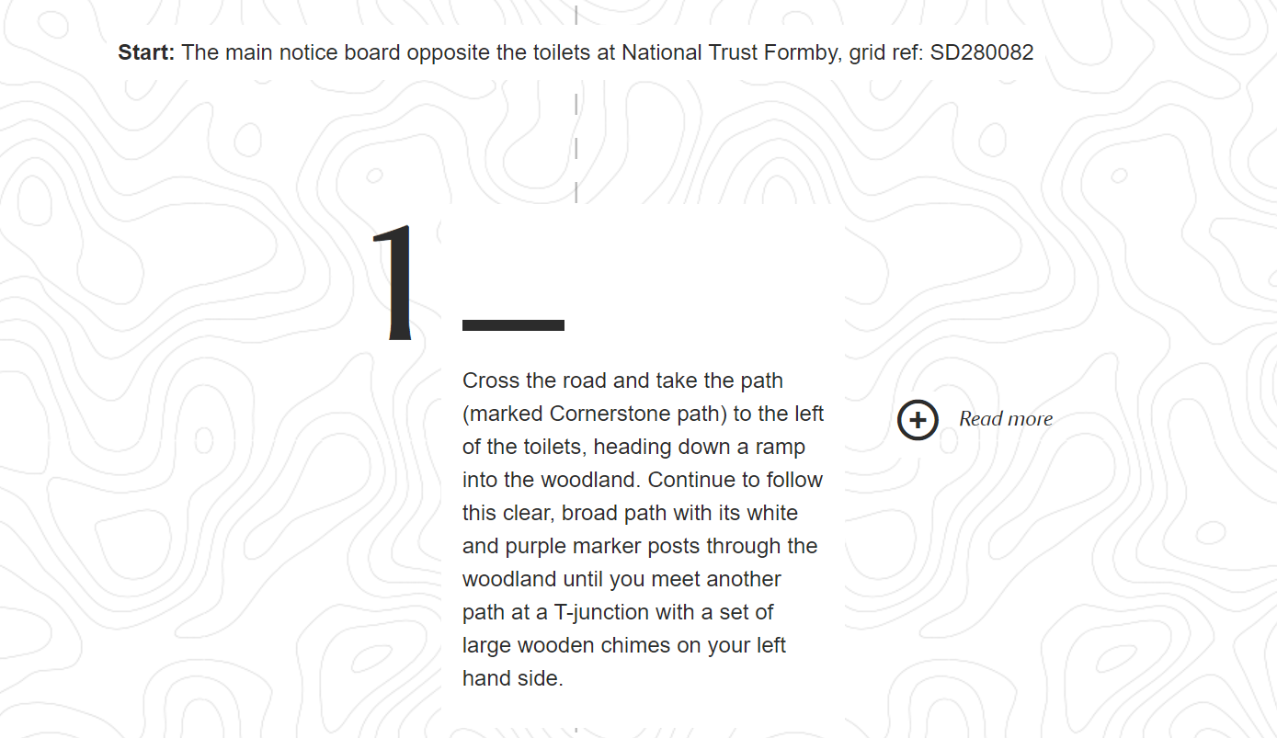

Slide 4
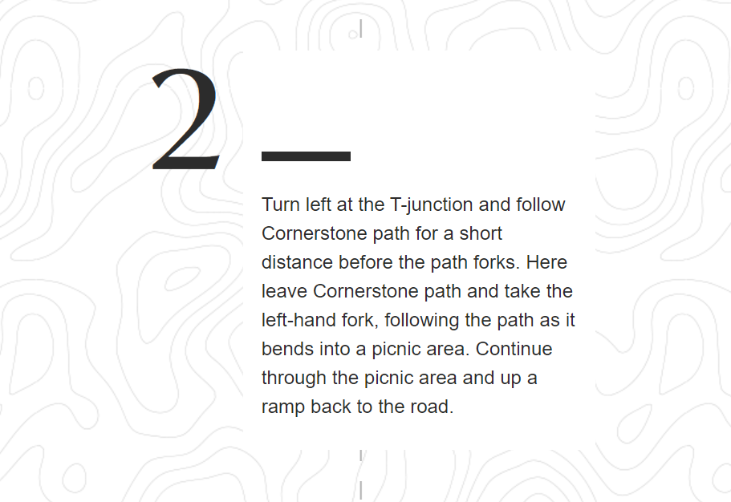

Slide 5
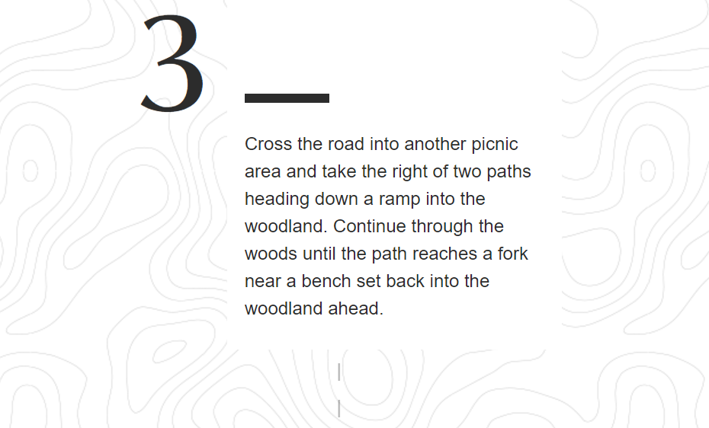

Slide 6
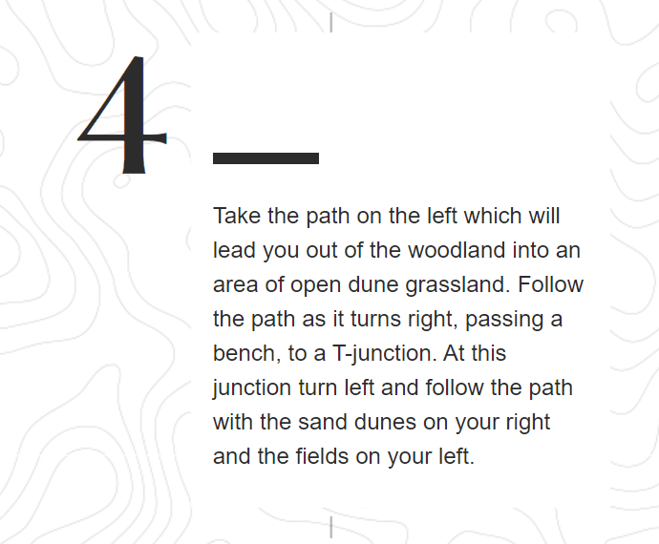

Slide 7
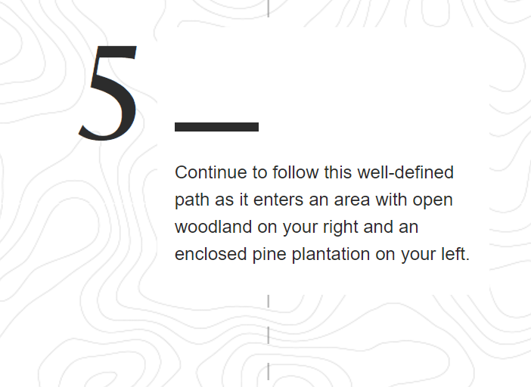

Slide 8
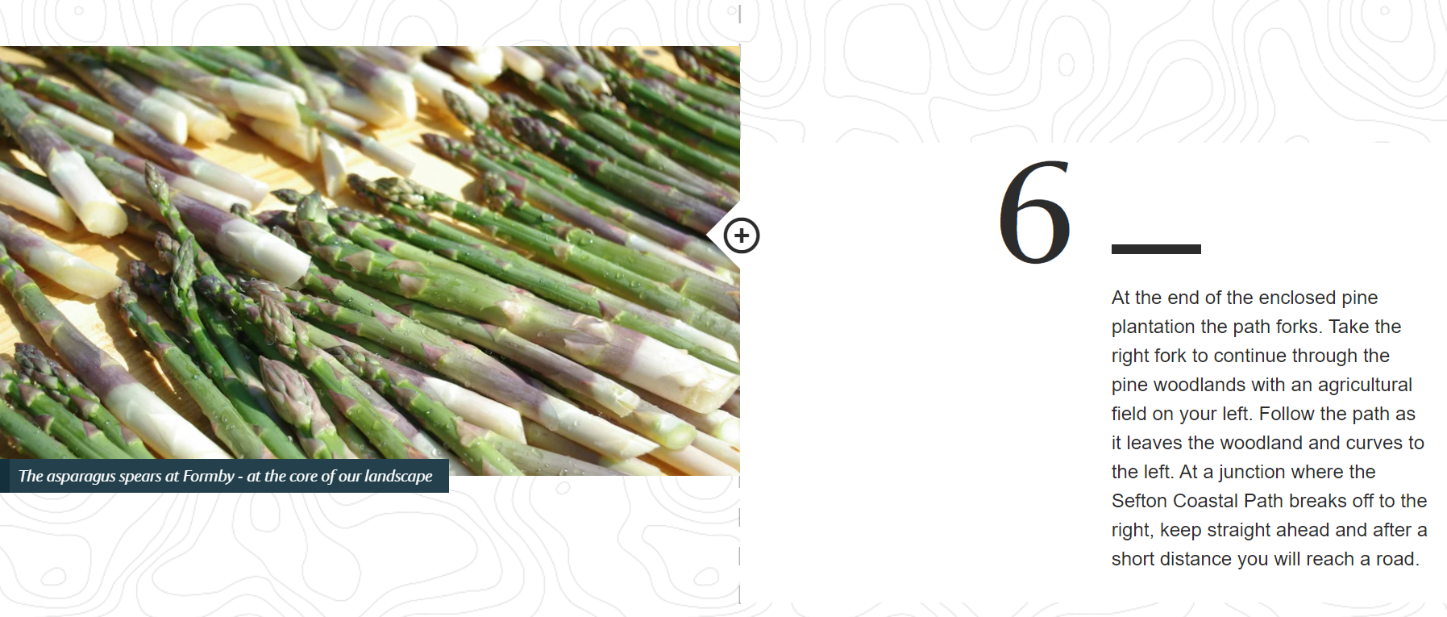

Slide 9
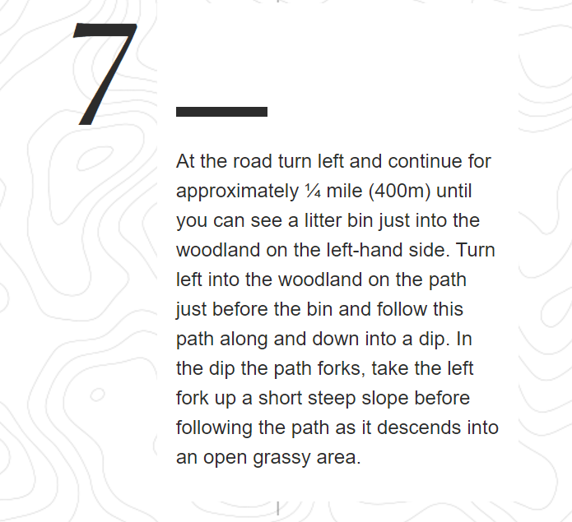

Slide 10
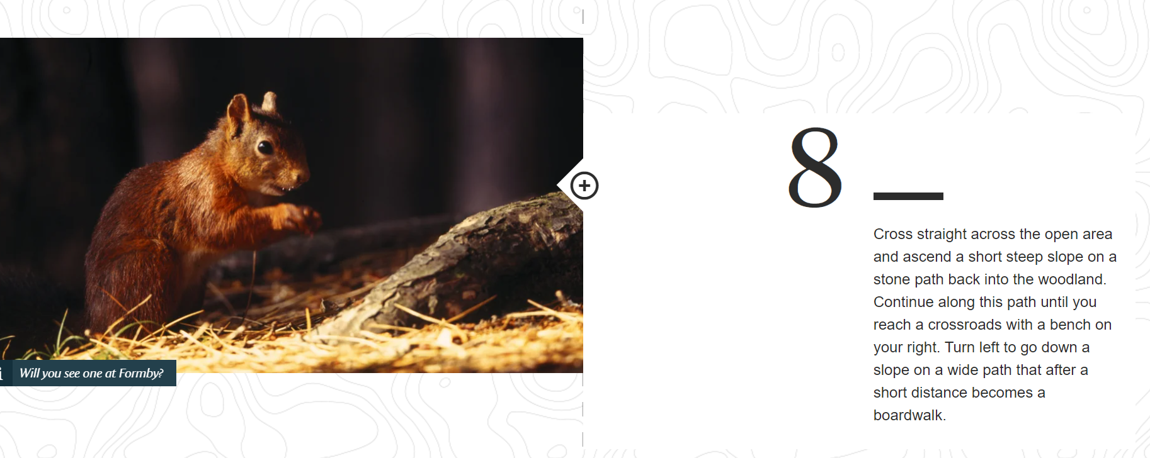

Slide 11
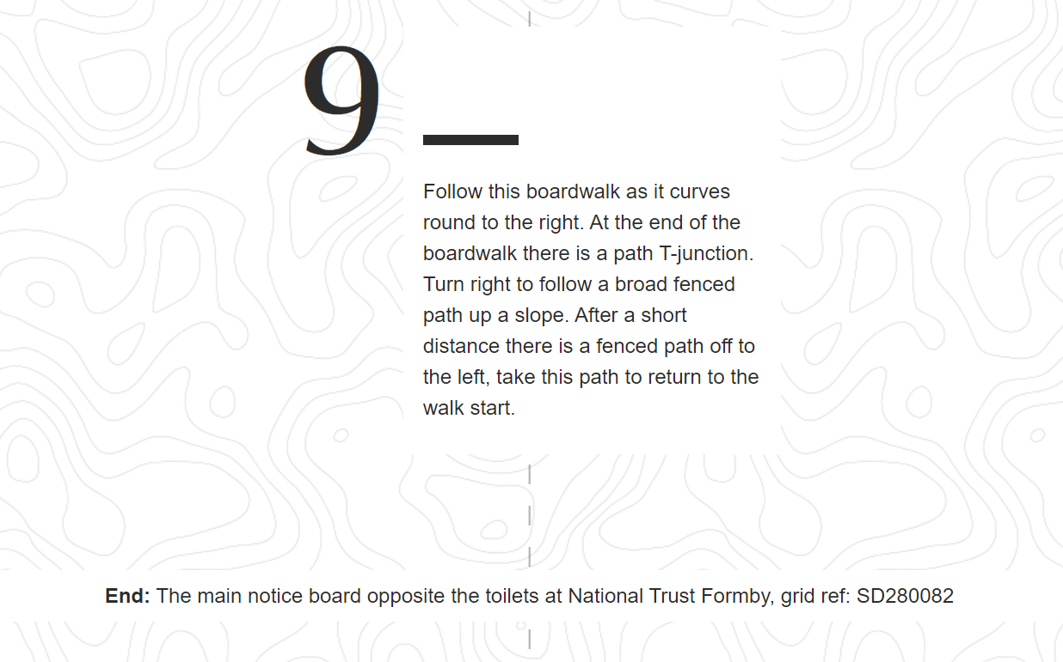

Slide 12
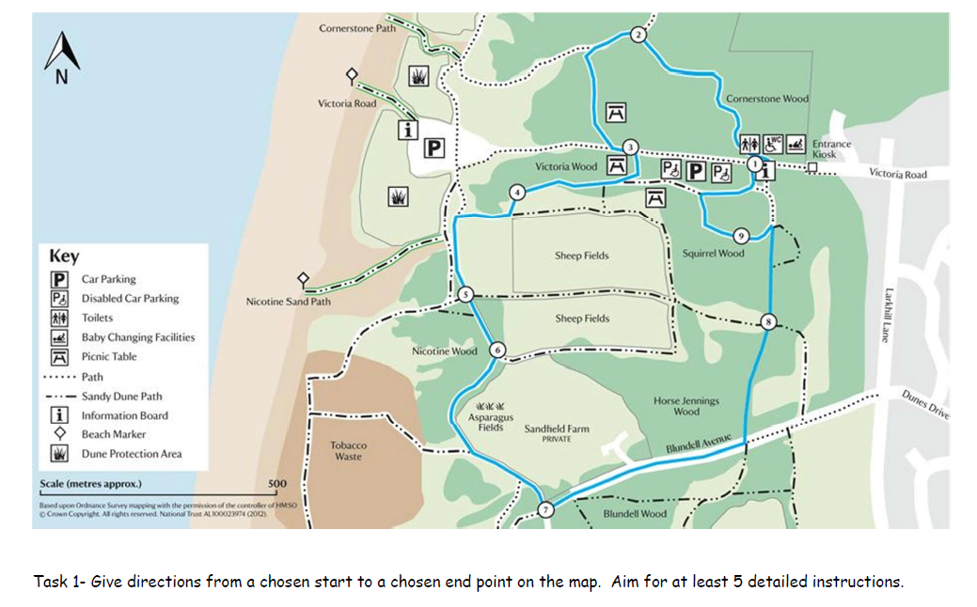
Today’s Tasks- TASK 1
We are going to write our own
directions from one
part of the map to another.
Choose your starting point
Choose your end point
Give clear directions to each part- use left/right
Describe things that you can see which would help people not lose their way. You can make these up!
Aim for at least 5 detailed points :D

Slide 13
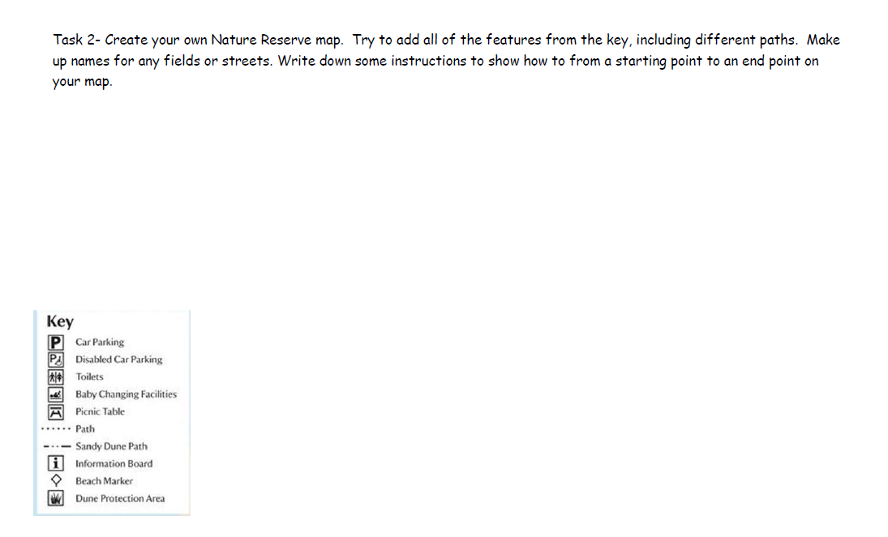
TASK 2
Create your own Nature Reserve map.
Try to add all of
the features from the key, including different paths.
Make up names for any fields or streets.
Write down some instructions to show how to get from a starting point to an end point on your map.

