Slide 1

KS2

Slide 2

We will learn:
about different things that make people feel different emotions
what helps our minds and bodies feel their best
how professional football players keep their minds
and bodies healthy.
I will be able to:
describe different feelings
say what helps someone feel good in their mind and body
identify and suggest examples that will help my mind and body feel good.
Notes:
Teacher notes
The activities covered in these slides can link to the following objectives from the PSHE education programme of study for KS2:
Core theme 1: Health and wellbeing
Healthy lifestyles (physical wellbeing)
H6. about what constitutes a healthy diet; how to plan healthy meals; benefits to health and wellbeing of eating nutritionally rich foods; risks associated with not eating a healthy diet including obesity and tooth decay.
H7. how regular (daily/weekly) exercise benefits mental and physical health (e.g. walking or cycling to school, daily active mile); recognise opportunities to be physically active and some of the risks associated with an inactive lifestyle
H8. about how sleep contributes to a healthy lifestyle; routines that support good quality sleep; the effects of lack of sleep on the body, feelings, behaviour and ability to learn
Theme 2: Mental health
H16. about strategies and behaviours that support mental health — including how good quality sleep, physical exercise/time outdoors, being involved in community groups, doing things for others, clubs, and activities, hobbies and spending time with family and friends can support mental health and wellbeing
In addition, the following objectives are covered by the other activities within this resource:
H17. to recognise that feelings can change over time and range in intensity
H18. about everyday things that affect feelings and the importance of expressing feelings
H19. a varied vocabulary to use when talking about feelings; about how to express feelings in different ways

Slide 3



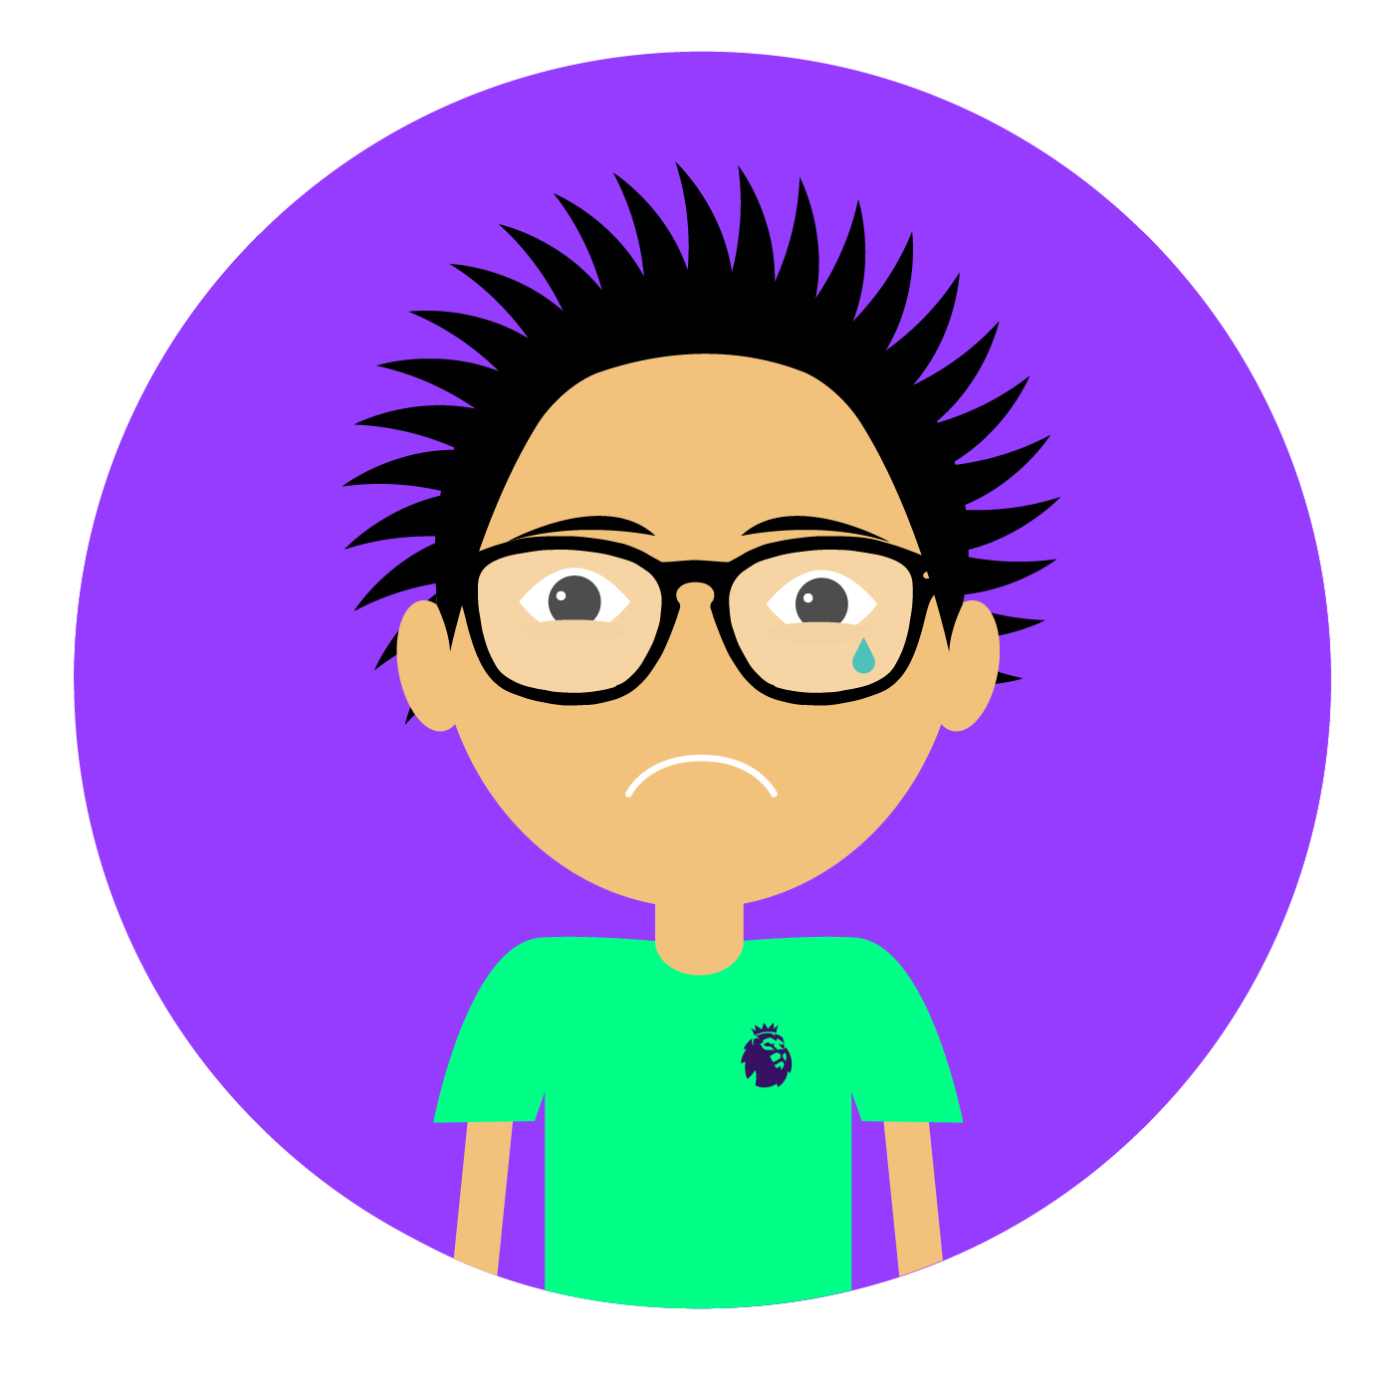
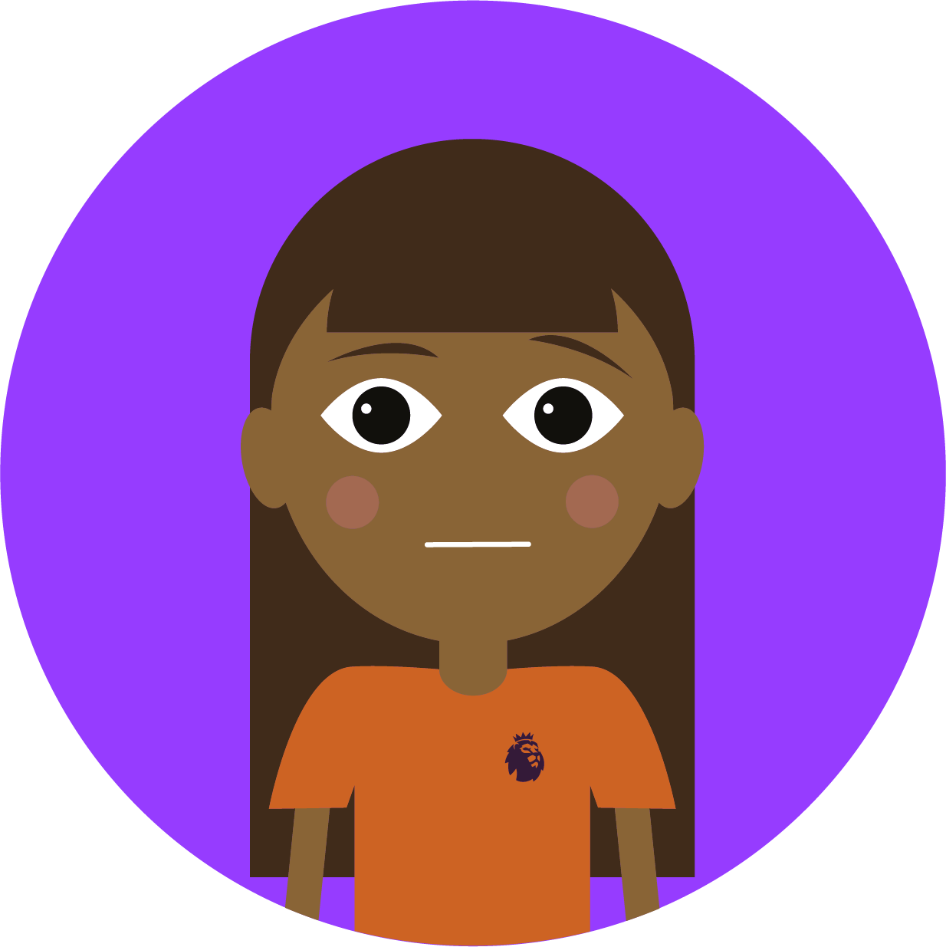
  Happy
Which emotions make us feel good?
Which emotions make us feel not so good?
When we're not feeling so good,
what can help us feel better?
  What helps our minds?
  What helps our bodies?
Everyone needs to feel good, even professional football players. How do you think they keep their minds and bodies feeling their best?
  Sad
  Worried
Notes:
Teacher notes
This slide could be used as a recap on the ‘Emotions flashcard' activity in the Wellbeing – feelings and emotions resource pack, or as a standalone to get pupils thinking about how they react to certain feelings.
Reveal each question on a click. Ask pupils to feed back on each question and gather a list of feelings (positive and negative). Remind pupils that the way we feel can affect our minds and our bodies.
Ask the class for ideas on what can make someone feel better, both in their minds and bodies, and gather some responses in a word cloud.
Ask them what they think professional football players might do to feel good and take some feedback, then tell them that they're going to hear from some football players about what helps them.

Slide 4
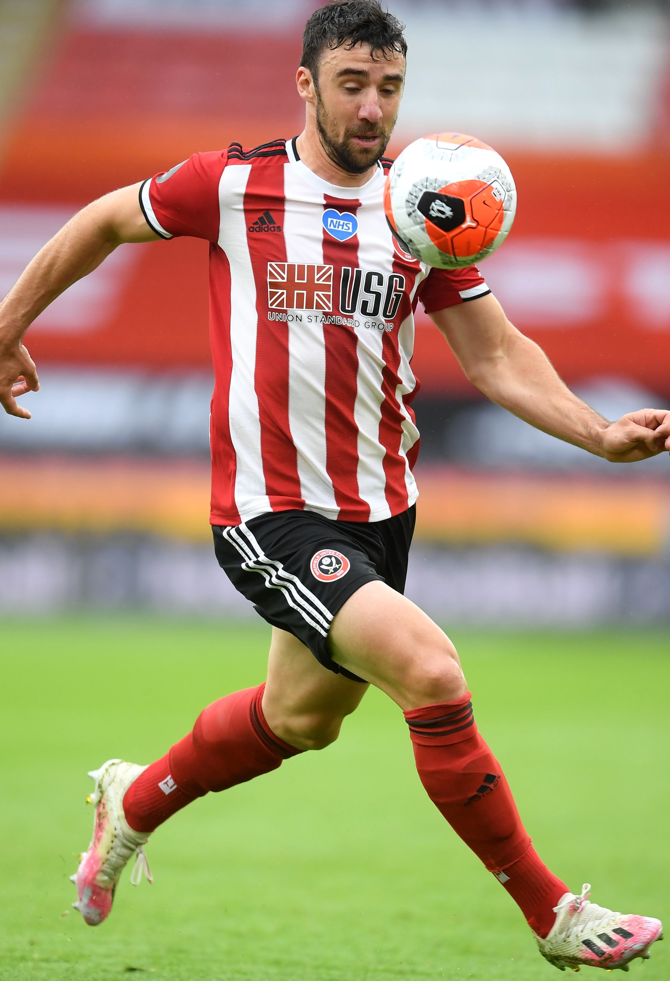



  “Exercise keeps me upbeat.”
  Enda Stevens
Football players have to be fit to play the game well, so they do a lot of exercise.
Keeping active affects how we feel; activity releases chemicals in our bodies which puts us in a better mood!
Tip: Set yourself an exercise goal each day. How do you feel afterwards?
Notes:
Teacher notes
Ask pupils why they think exercise helps Enda Stevens feel good.
Ask them what kind of exercise any of them do, and how it makes them feel afterwards. Emphasise that this could be any activity e.g. walking, cycling, scooting, running as well as team games, or even just playing outside in a park or playground as long as they're moving their bodies.
Ask pupils to write down an exercise/activity goal and count how many times they achieve it. They could also write or draw a picture showing how the activity makes them feel.
Pupils might not understand the term ‘upbeat’. Explain that to be upbeat means that someone is happy and cheerful.
The photo displayed on the slide is of Enda Stevens and plays for Sheffield United. Enda Stevens’ quote is at 2 minutes 45 seconds.
NB: The video interview was filmed as part of Mental Health Awareness Week during lockdown, May 2020.

Slide 5
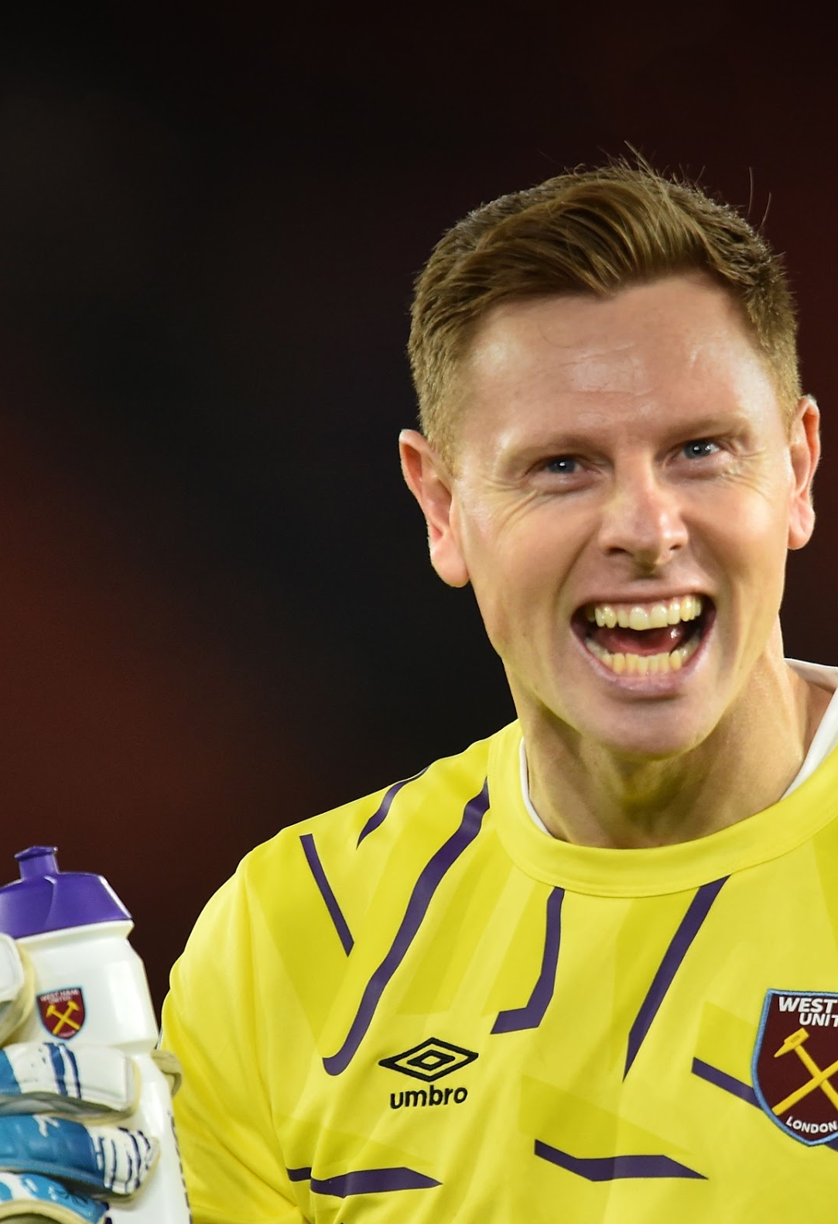


  “Keep yourself hydrated”
  David Martin
Drinking water helps us concentrate
and think clearly.
What we eat affects how we feel. If you eat unhealthily, you won’t feel as good as you can do.
Eat a 'rainbow plate' of fruit and vegetables to get a healthy mix.
Tip: Take a refillable bottle of water with you. Instead of sweet snacks, eat a piece of fruit.
Notes:
Teacher notes
Ask pupils if they know why our bodies need healthy food and water. If we only ate unhealthy foods, how would our minds and bodies feel?
Discuss examples of healthy and unhealthy foods, and why it's important to avoid fizzy or sugary drinks.
The photo on the slide is of David Martin who plays for West Ham United staying hydrated on the pitch. David Martin’s quote is at 2 minutes 30 seconds.
NB: The video interview was filmed as part of Mental Health Awareness Week during lockdown, May 2020.
There is also more about how to eat a healthy diet in the Eat the rainbow resource pack (https://plprimarystars.com/resources/eat-the-rainbow) and Hydration (https://plprimarystars.com/resources/hydration) resource pack.

Slide 6
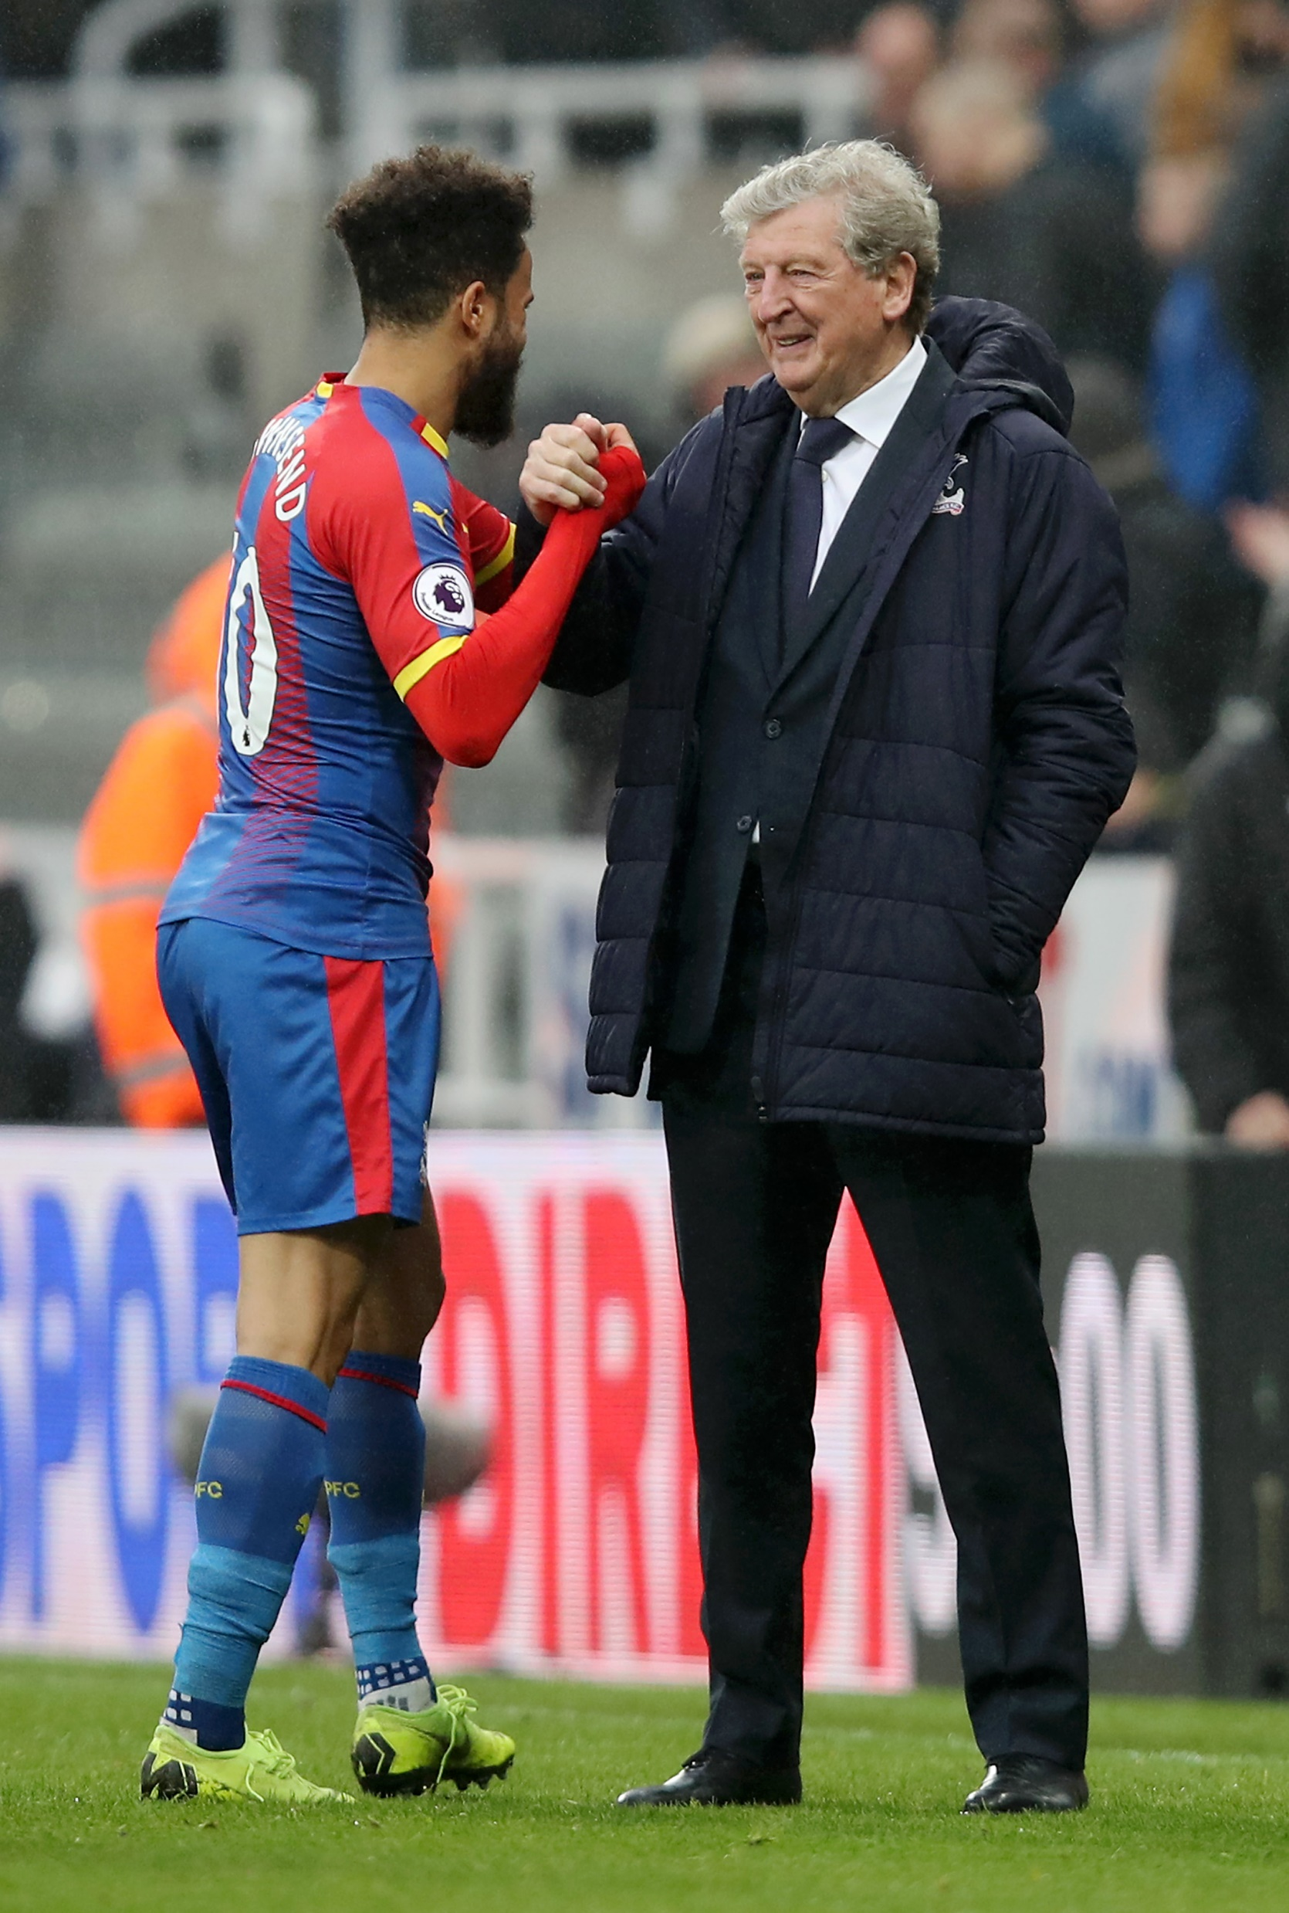

  “Speak to someone ... get your problems off your chest so they’re not bubbling up inside.”
  Andros Townsend
If we feel worried or confused about something, it helps to talk.
Talking to someone we trust about difficult or upsetting thoughts can help negative feelings go away.
Tip: If it's difficult to talk, write down or draw a picture to show how you feel?
Notes:
Teacher notes
Explain that often we want to keep our feelings to ourselves, but if something is bothering us or making us feel worried it's good to talk to someone about these feelings.
Ask pupils how it can help when we talk about feelings with someone.
Ask them for some examples of who people can talk to (e.g. friend, parent, teacher).
Tell pupils that writing down or drawing how they are feeling can help, even if they don't share the result with anyone. Sometimes it just helps to get it out of your head.
The photo on the slide is of Andros Townsend who plays for Crystal Palace talking with Manager Roy Hodgson. Andros Townsend’s quote is at 1 minute 16 seconds.
NB: The video interview was filmed as part of Mental Health Awareness Week during lockdown, April 2020.

Slide 7
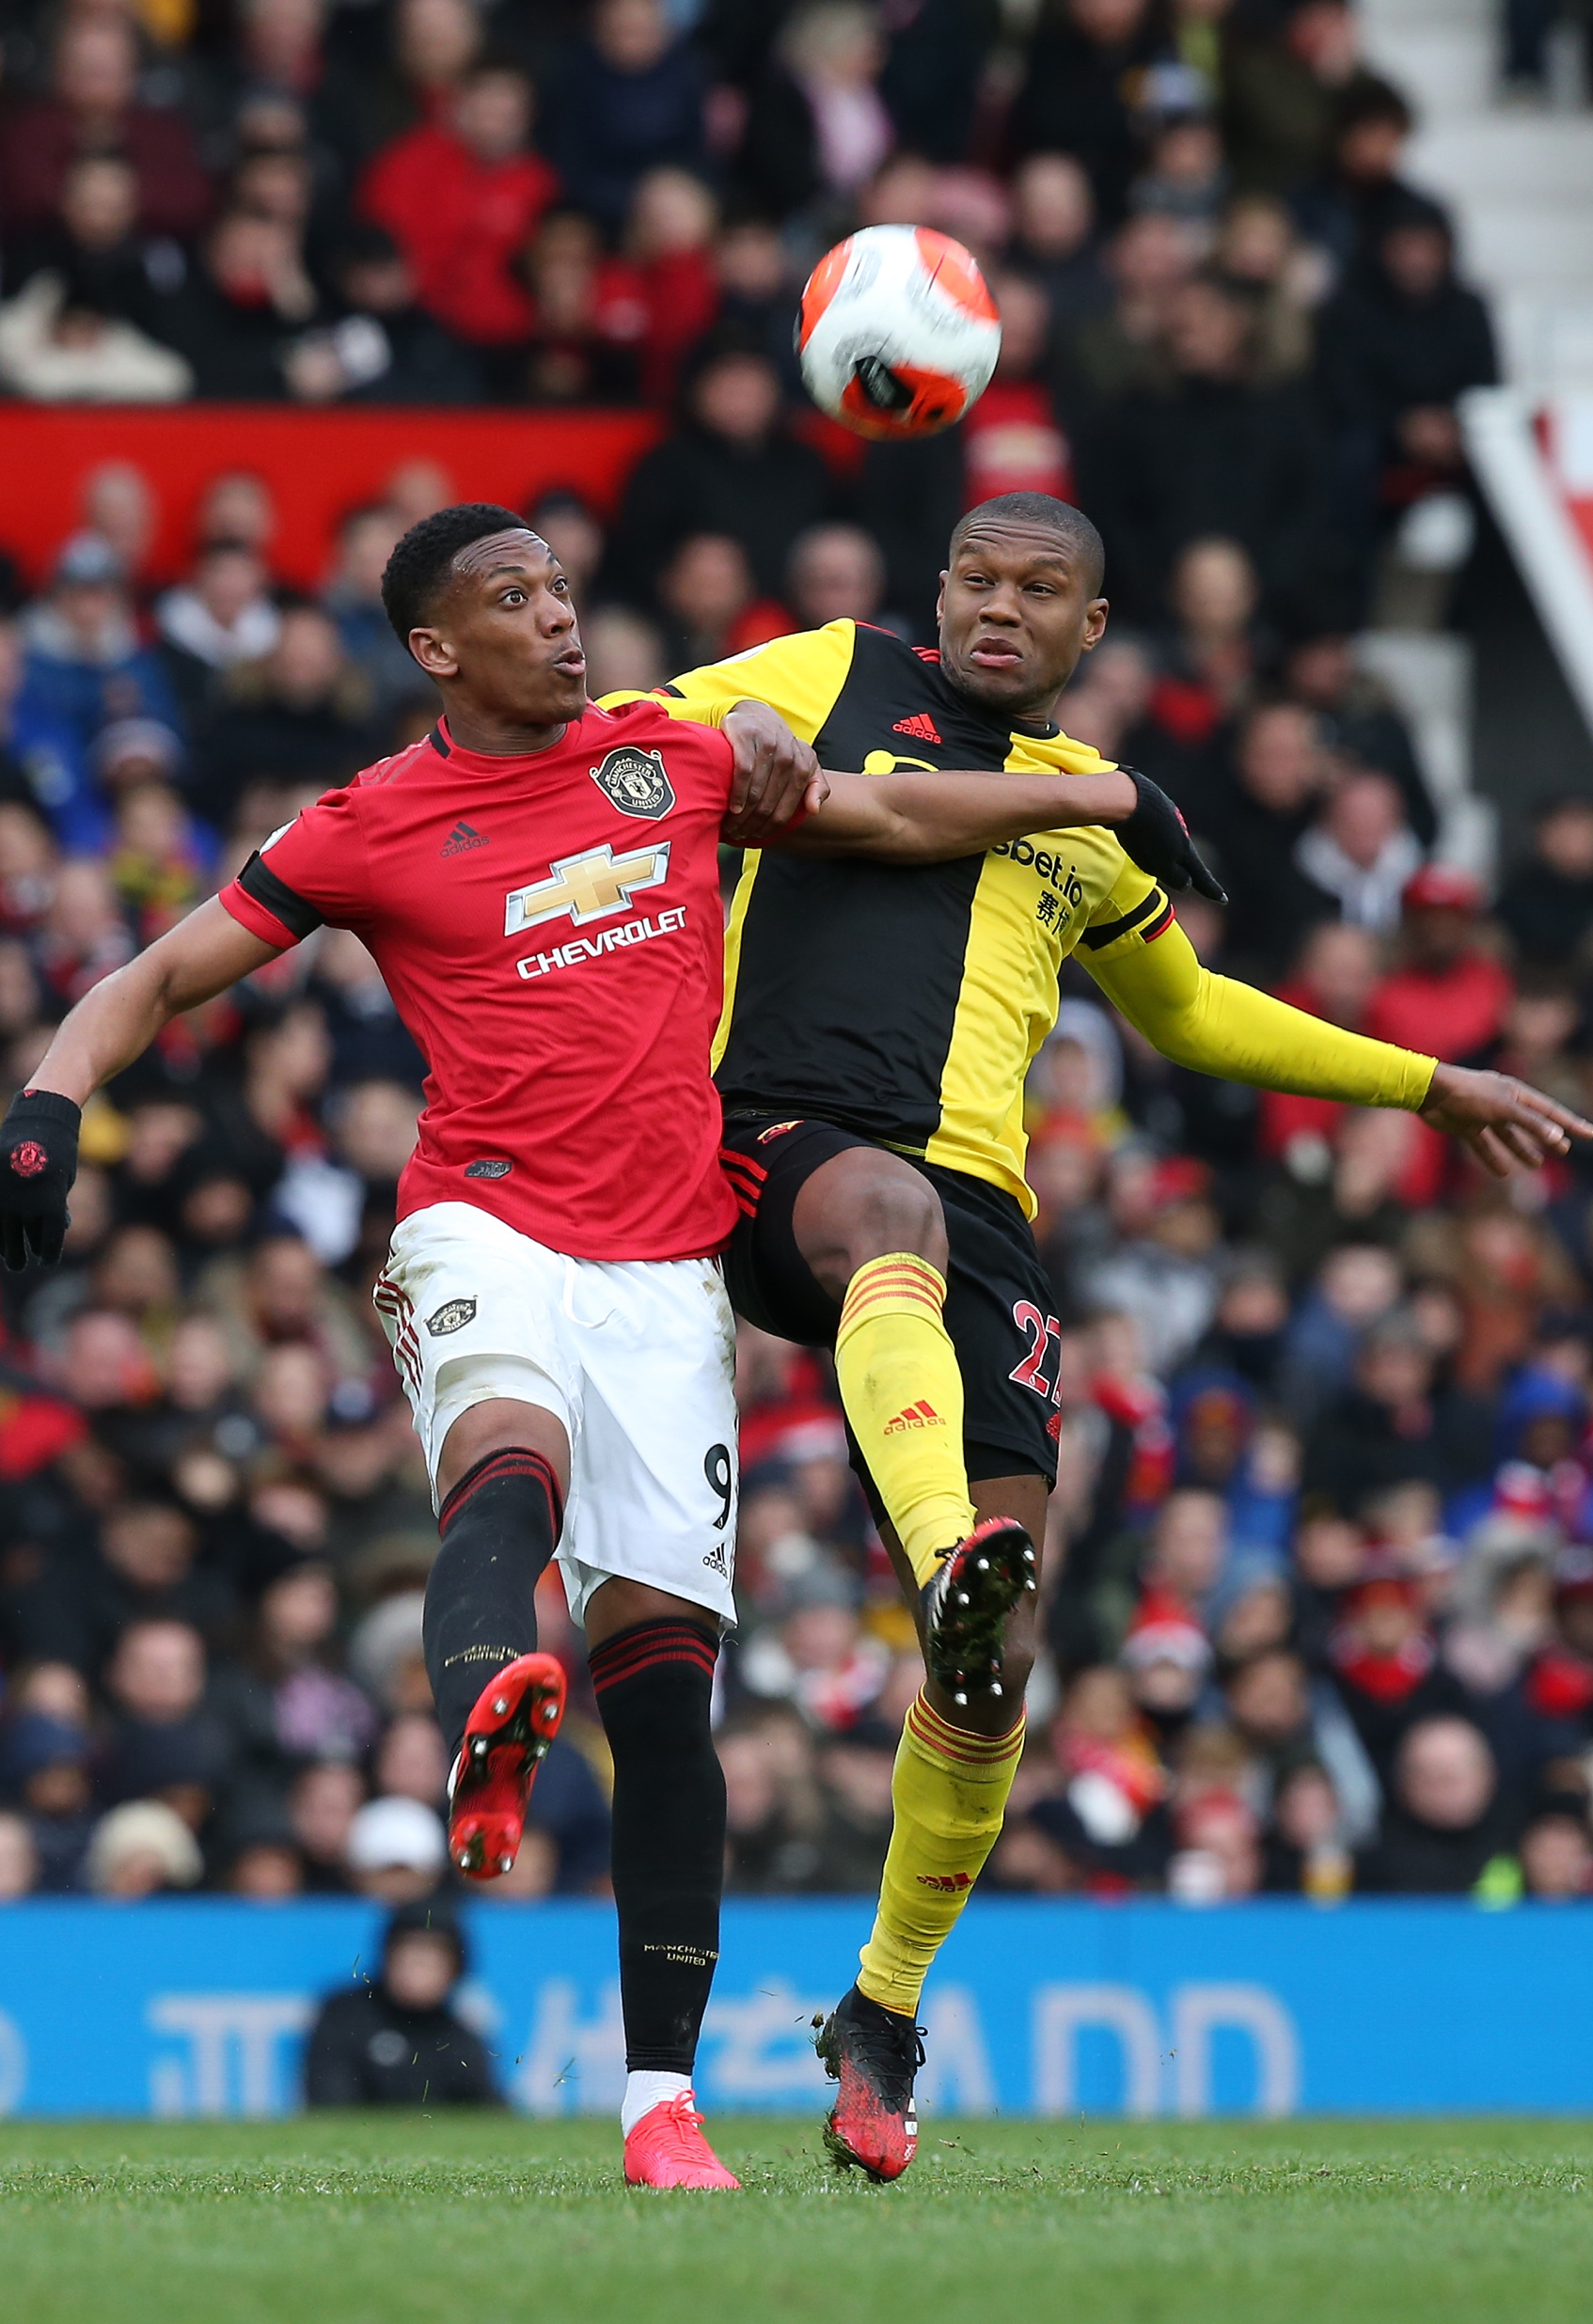


Learning new things keeps our minds active.
Using a new skill helps people feel good about themselves!
  "Now I'm cooking more than usual... and to be honest I’m quite good.”
  Christian Kabasele
Tip: Spend some time practising a new skill each day. How does it feel when you get better?
Notes:
Teacher notes
Ask pupils which feelings they might have if they had learned a new skill (e.g. pride, satisfaction, pleasure). How do these feelings help us?
Ask pupils to identify any skills or activities which they would like to try out in school. Encourage them to have a go at them each day, and to share their feelings about them afterwards.
The photo on the slide is of Christian Kabasele of Watford with Anthony Martial of Manchester United.
NB: The article was written as part of Mental Health Awareness Week during lockdown, April 2020.
Explore the Resilience resource pack (https://plprimarystars.com/resources/resilience) where pupils will learn how to demonstrate helpful ways to manage emotional responses to difficulties, challenges or setbacks.

Slide 8
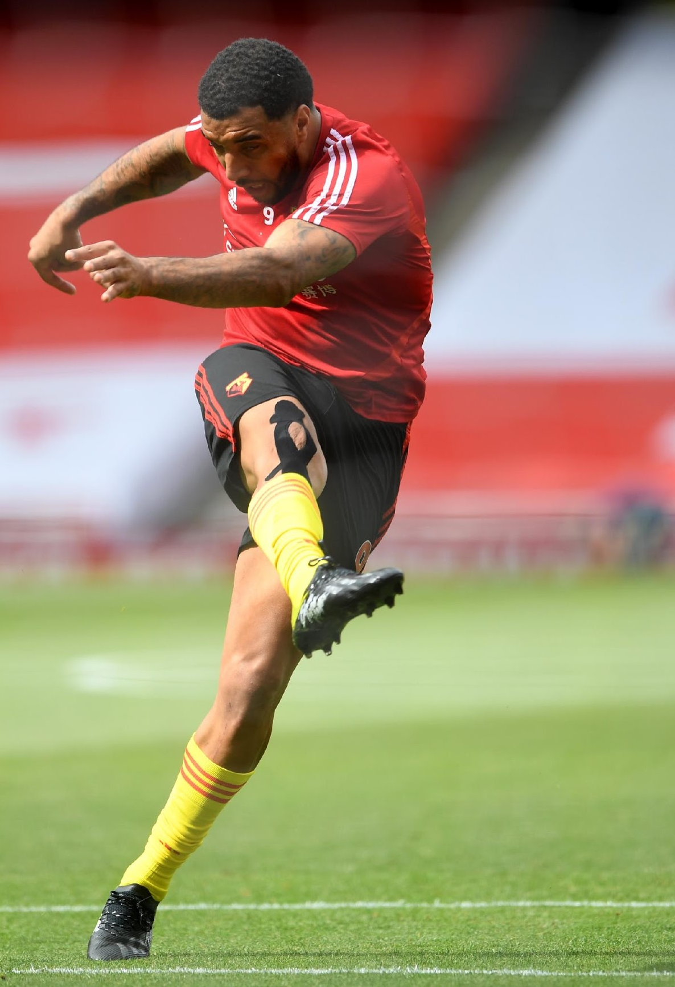

  “Take a few breaths. The best thing I can do is walk away, practise my breathing ...and then think
  about the situation.”
  Troy Deeney
Thinking about your breathing can help you focus and feel calmer about decisions and choices.
Tip: Next time you need to feel calmer, try breathing in then out slowly.
Do this a few times - does it help?
Notes:
Teacher notes
Obviously we are always breathing, but ask pupils why they think Troy Deeney finds it helpful.
How is the breathing Troy describes different to the breathing we do all the time?
Can pupils think of any situations where doing what Troy describes be a good idea?
Practise slow breathing in and out to a count of three or four with pupils. They could do this in and out of their nose, or in through their noses and out through their mouths. Take it further by asking them to close their eyes and ask how they feel afterwards.
The photo on the slide is of Troy Deeney who plays for Watford. Troy Deeney’s quote is at 10 seconds.
NB: The video interview was filmed as part of Mental Health Awareness Week during lockdown, April 2020.

Slide 9
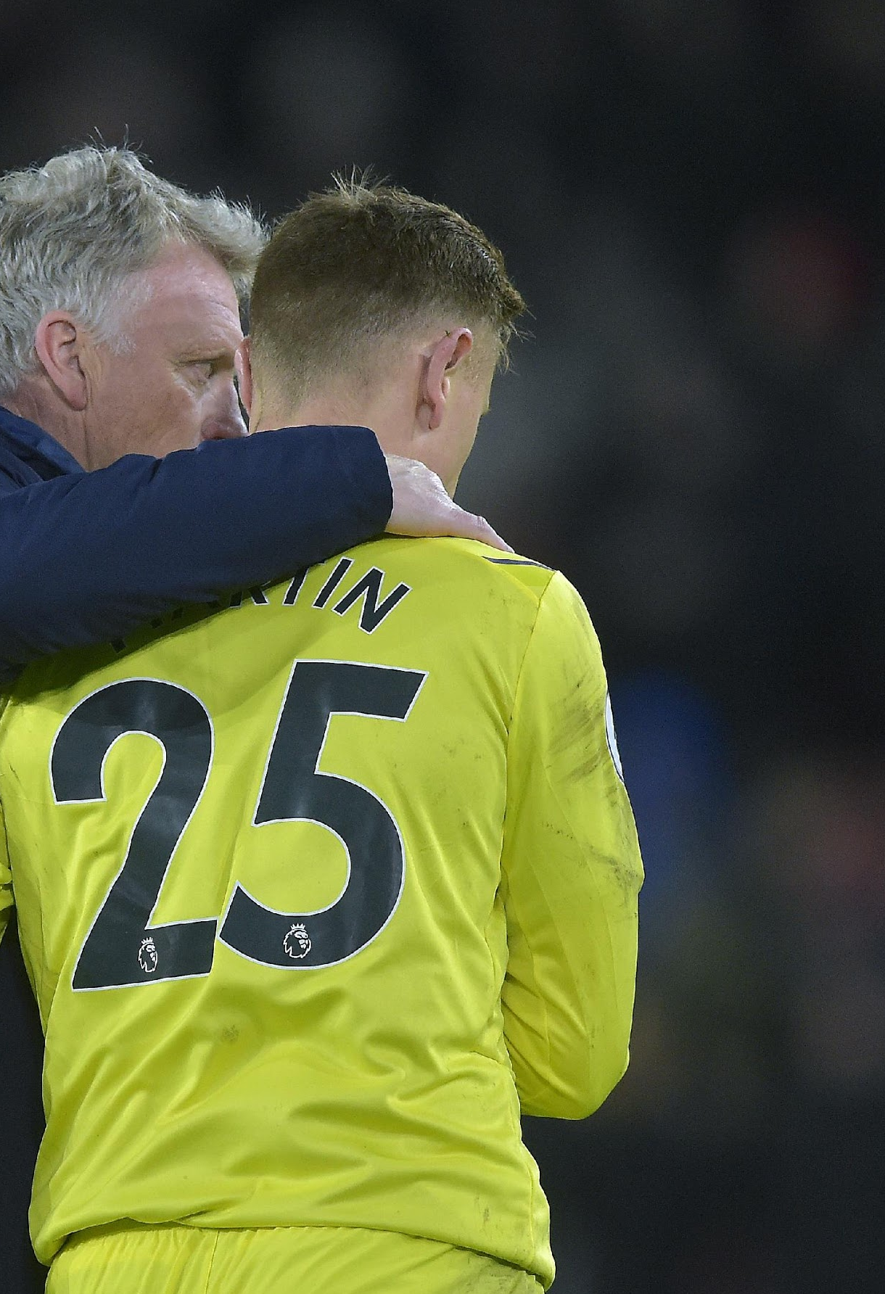

  “For me the most important thing is sleep… the next day... you feel you’re ready to go and achieve something.”
  David Martin
Sleep helps our bodies and brains grow and develop. It gives them the energy they need to be healthy.
If we don't get enough sleep, we can get grumpy and irritable, we can't concentrate and it's harder to enjoy things.
You should get 9 to 12 hours of sleep each night.
Tip: Do something calming before bedtime: read a book, listen to soft, calm music, have a warm bath, put screens away. What helps you?
Notes:
Teacher notes
Ask pupils why David Martin thinks sleep is so important for minds and bodies. Highlight some of the ways in which it benefits us.
Ask pupils if they have ever had a bad night’s sleep and how they felt the next day. Use examples such as babies, who cry and get angry when they are tired, or older siblings or parents who might get cross and forgetful when they've had a late night.
Discuss things which can help someone get a good night's sleep and ask for suggestions e.g. routines at bedtimes, not going to bed late on a school night, not using screens just before bedtime etc.
The photo on the slide is of David Martin, goalkeeper for West Ham United. David Martin’s quote is at 2 minutes 35 seconds.
NB: The video interview was filmed as part of Mental Health Awareness Week during lockdown, April 2020.

Slide 10
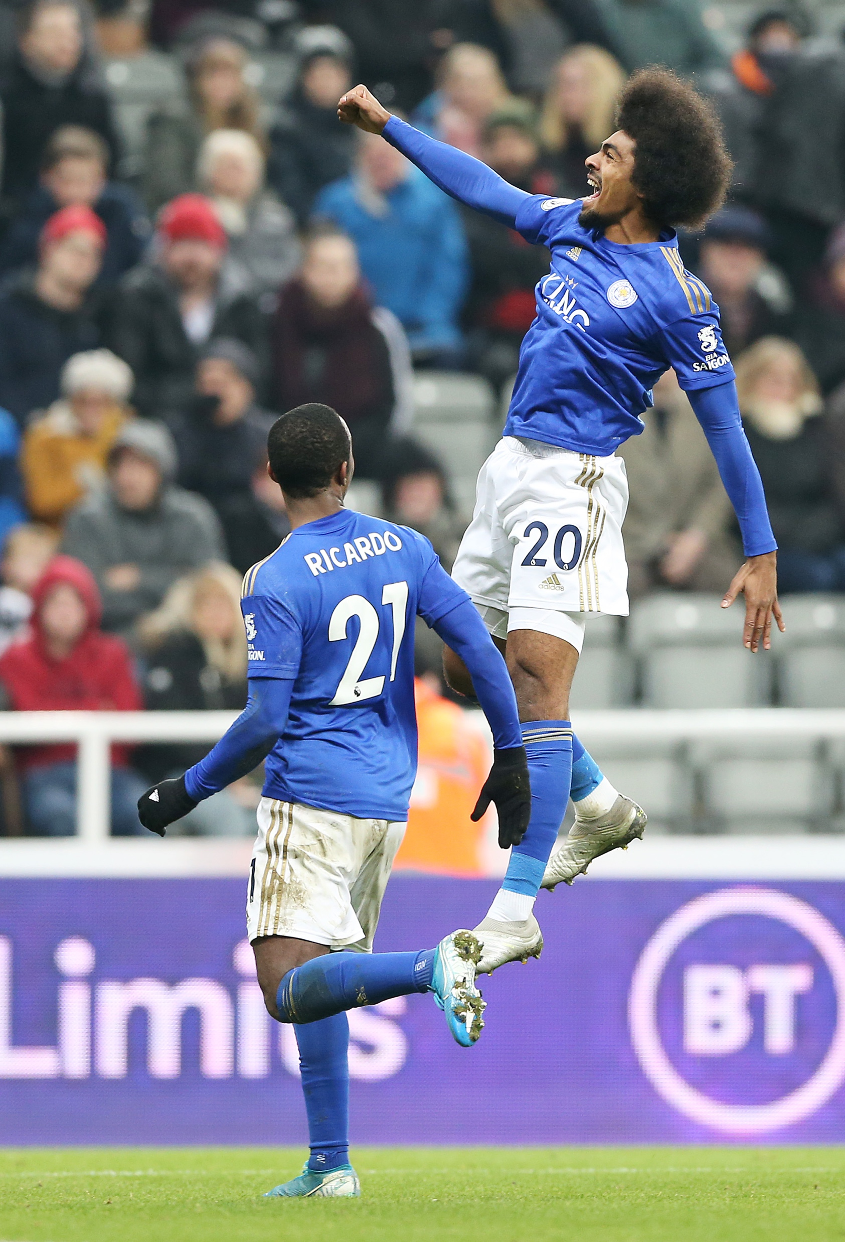

Set goals for the things you want to achieve and try to work towards your goal every day. This helps you stay focussed.
  “Setting a goal really makes a difference to how your day goes.”
  Hamza Choudhury
Tip: Set yourself a goal for this week or this term. What steps can you take towards it?
Notes:
Teacher notes
Ask pupils why they think it helps to set goals for ourselves. What kinds of goals might a footballer like Hamza Choudhury set?
Ask pupils what kinds of goals people of their age might set for themselves. These could be related to school, to home, to a skill, to learning or for their relationships with other people. What steps could take them towards achieving those goals?
The photo on the slide is of Hamza Choudhury who plays for Leicester City. Hamza Choudhury’s quote is at 2 minutes 7 seconds.
Explore the Home/school - Try your best challenge resource pack (https://plprimarystars.com/resources/try-your-best) where pupils will be encouraged to set a goal and learn a new skill.

Slide 11


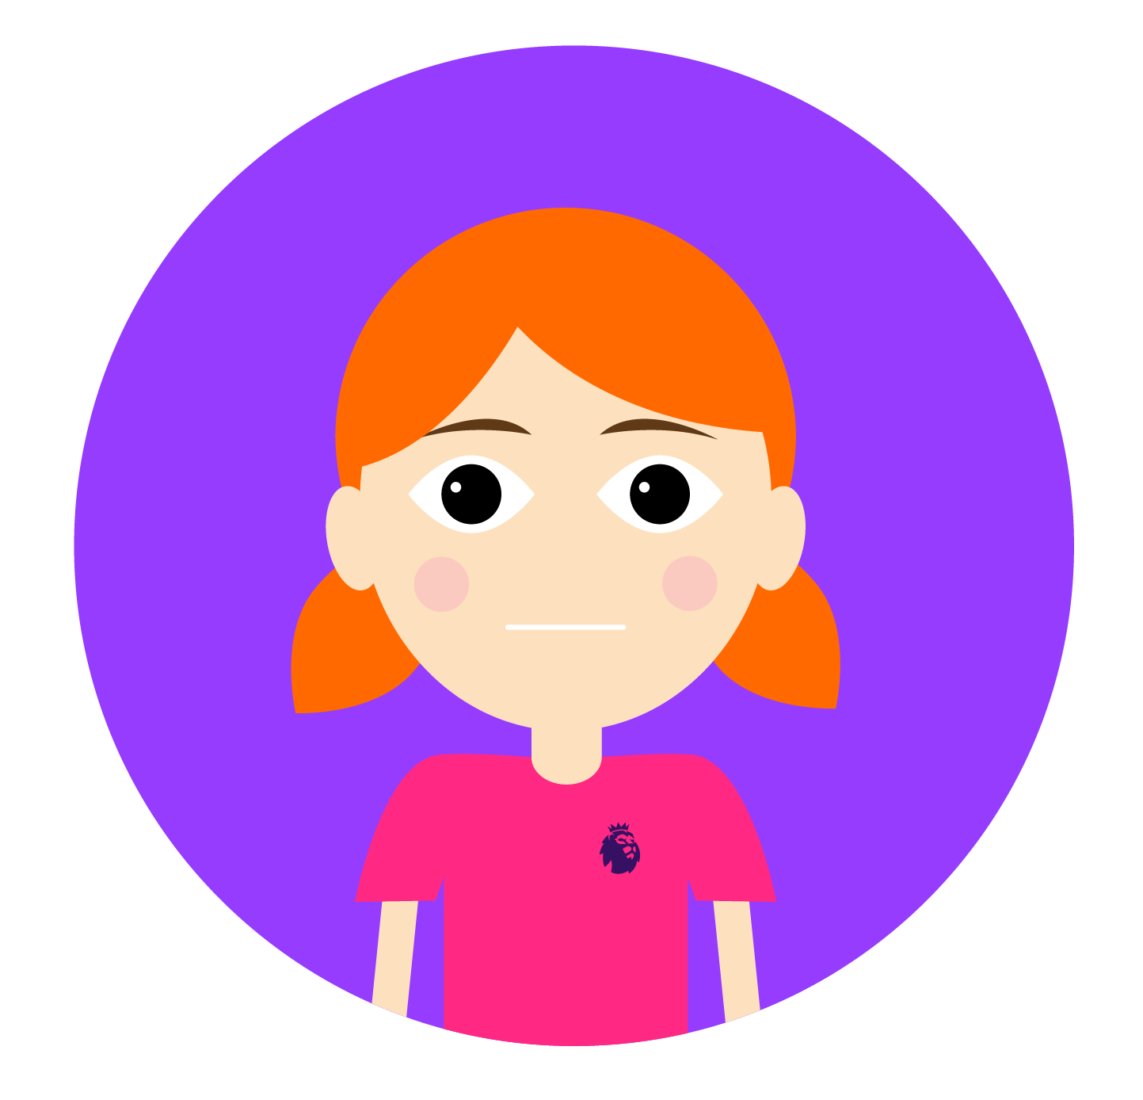
PSHE Resource
Managing our emotions
  What am
  I feeling?
  Can
  I help?
  Yes
  I can!
Notes:
Teacher notes
Ask pupils for any other ways that help minds and bodies feel good, then click to reveal the three questions on the slide.
Discuss the questions on the slide:
How can we work out how we feel?
Why can helping other people make us feel good?
How we can help other people?
How can we change negative thoughts to positive thoughts?

Slide 12

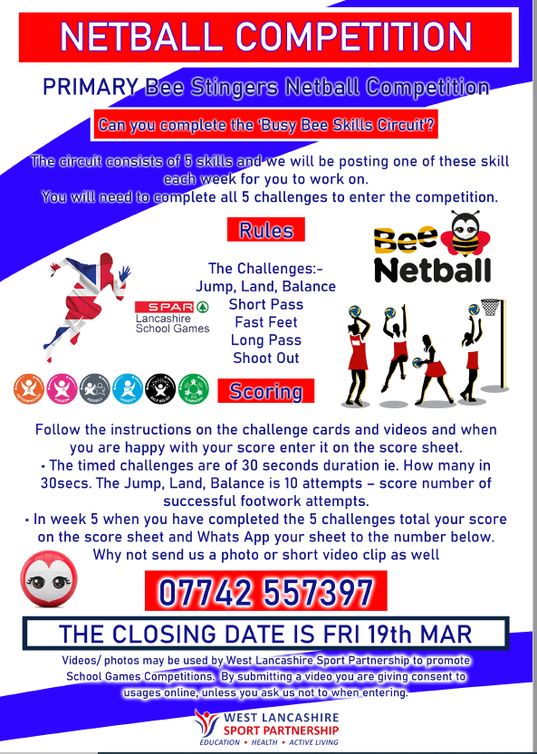
WLSP Challenges to try.

