Slide 1

Welcome to Willow Class.

Slide 2
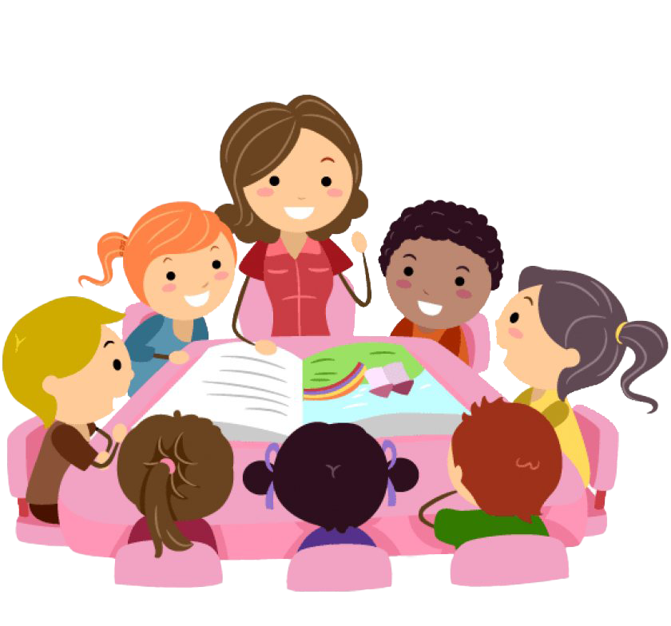
Our staff....
Miss Peake – Class Teacher
Mrs Williams – Teaching Assistant
Ms McPherson – Teacher 9:00 – 10:25am each day with Year Two. Thursday 2:30 – 3:30pm (Willow Class)
ThePhoto by PhotoAuthor is licensed under CCYYSA.

Slide 3
Daily routine.
We have a maths and phonics/spelling session each morning. Ms McPherson teaches the Willow Flowers (Year Two) and Miss Peake teaches the Willow Buds (Year One) for these sessions.
We have an English lesson each morning when we share a variety of texts and practise our writing. We also have a Maths Mastery lesson when we practise our basic number skills.
Our Foundation Subjects including History, Geography, Science, PE, Music, PSHE, Art etc. are taught in the afternoons.
We have three assemblies and a singing session in the hall each week. We also have a class collective worship time on Wednesdays.
We have two PE lessons each week. Our PE days are Tuesdays and Thursdays.
We have very busy days!

Slide 4
Curriculum
In Year One and Two the children follow the National Curriculum in all subject areas.
Our main topics include:
Science - Ourselves , Plants and how they grow, Animals and their habitats and Materials.
History – Toys Through Time, Great Fire of London and Queen Elizabeth II.
Geography – Our locality (mapping), Four countries and capital cities in the UK and Oceans and Continents.
Art – Self Portraits (Katie Kollwitz), Weaving, Observational drawing (Van Gogh) and Collage (Henri Rousseau)
DT – Moving storybooks, Healthy Wraps and sewing pouches.
We also look closely at seasonal/weather changes throughout the year.

Slide 5
Trips
Science – Year One go on an Autumn walk to the quarry to look for changes in the environment and visit Blackpool Zoo in the summer term. Year Two will have a visit related to our Habitats topic during the summer term (tbc).
Visitors to school – Dylan's Reptiles visits school in the summer term, bringing a menagerie of creatures!
Events.
The children will perform in a Christmas assembly in December.
Key Stage 1 Sport Day will take place in the Summer Term
Dates are to be confirmed.

Slide 6
Reading
Reading continues to be very important in Year One and Year Two. The children will continue to access the books from the Little Wandle Letters and Sounds Scheme and an e-reader will be issued each Friday. They will have previously read this book in school. Please practise this book at home. Your child can use their phonic knowledge to read all the words in this book.
Your child will also be given a shared book each week. We ask you to read this book together, encouraging your child to read the words they recognise.
All children will have the opportunity to choose a library book (bedtime story) each Friday. This is purely for enjoyment. The children really enjoyed recommending texts to each other last year!
Year 2 – fluency books – not on e-reader and read twice weekly.

Slide 7
Year One – Phonics.
During Reception the children have learnt Phase 2,3 and 4. In Year One they move onto Phase 5 after a revision of Phase 3 and 4.
In June 2025, the children from Year One are required to complete a Phonics Screening Check and are given a score out of 40.
Lots of information in the pack.

Slide 8
Year Two - Phonics into Spelling.
In the first half term children in Year Two will complete a Phase 5 review which provides a revision of the sounds learnt last year. They will practise reading and writing words containing those sounds as well as the tricky words previously practised.
After October half term they will complete a 'Bridge to Spelling' unit and from January they will follow the Little Wandle Spelling Scheme. They will then be given ten words each Friday which they can practise at home for a test the following Friday.
(Handouts in pack)

Slide 9
Handwriting
This year we will continue to practise letter formation. It is important that the children learn to write their letters the correct way around and to form them correctly.
The children in Year Two will start to practise their 'joined' handwriting.
We will also practise the correct formation for the digits 0-9.
(Resources in pack)

Slide 10
Equipment
A reading bag – please provide an A4 zip wallet for your child’s books. This should be sent into school every Friday. Please mark this clearly with your child's name.
A pair of black pumps in a red school PE bag.
A school bag – please do not send in any rucksacks as we struggle for space in the cloakrooms. School bags can be ordered from the school office.
A suitable coat every day - we go outside regardless of the weather!
A colouring/puzzle book and colouring pencils/pens for rainy day lunches.
Year Two - After Christmas we learn to play the recorder so maybe put one on their Christmas List!

Slide 11
Snack
Please ensure your child brings a water bottle to school each day. This can be refilled during the day if necessary. Please avoid sending bottles with full caps as these often get spilt. Sports cap is best!
The children can also have a carton of milk each day. If you would like your child to have milk please order online.
The children continue to have a piece of fruit provided by Lancashire County Council each day.
You can send an extra piece of fruit each day if your child would like more. Please continue to cut grapes and nectarine segments. Place bananas, oranges or apples in a bag or container marked with your child's name.

Slide 12
Homework
We will provide a variety of tasks which will run over the half term. You may choose a task each Friday and post your photos on dojo by Wednesday of the following week.
PE
Our PE lessons are on Tuesdays and Thursdays. Children wear their PE kits to school on these days. During the colder weather children may wear navy joggers or leggings. Please ensure your child wears trainers with velcro fastenings if they are not able to tie their own laces.

Slide 13
Voluntary contribution.
Thank you!

Slide 14

We look forward to spending this year with your children. They have all settled really well and are working hard already. We are very proud of them all.
We are using dojos as our reward system this year. Please share your child's achievements at home and give them lots of praise. They are all fantastic!

