Slide 1
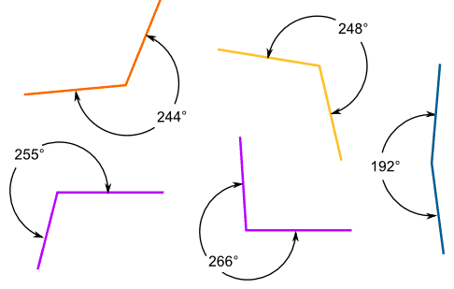
Calculating angles

Slide 2
Today we will:
Find missing angles between intersecting lines.
Find missing angles in triangles
Find missing angles in quadrilaterals.

Slide 3
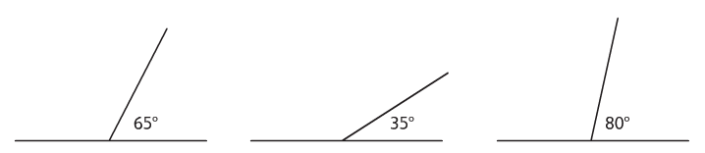
Missing angles on a straight line
Remember:
  Angles on a straight line add up to 180°
  To calculate a missing angle on a straight line, take away the known angle from 180°
  Eg:
  180° - 65°=
  115°
  180° - 35°=
  145°
  180° - 80°=
  100°

Slide 4
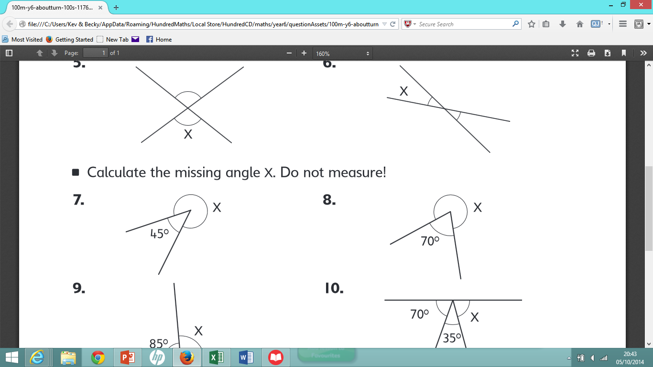
missing angles in a full turn
Remember:
  Angles in a full turn add up to 360°
  To calculate a missing angle in a full turn, take away the known angle from 360°
  Eg:
  360° - 70°=
  290°
  360° - 45°=
  315°

Slide 5
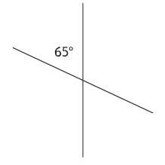
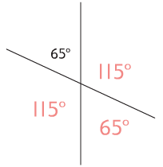
missing angles on intersecting lines
Remember:
All 4 angles will add up to 360°
Opposite angles on a cross are equal
Eg:
Step 1: Opposite angle is equal
Step 2: 65° + 65° = 130°
360° - 130° = 230°
Step 3: 230° ÷ 2 = 115°

Slide 6
Missing angles within turns
Straight lines
180° - known angles
Full turns
360° - known angles
Intersecting lines
Opposite angles are equal
You should now be able to complete questions 1-6 without a protractor.

Slide 7
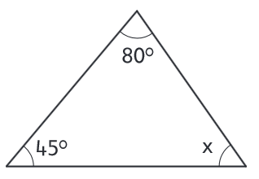
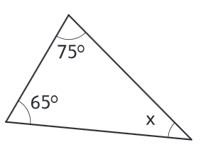
Missing angles in triangles
Remember
  All angles in a triangle add up to 180°
  To find the missing angle, add the known angles and subtract from 180°
  65° + 75° = 140°
  180° - 140° = 40°
  80° + 45° = 125°
  180° - 125° = 55°

Slide 8
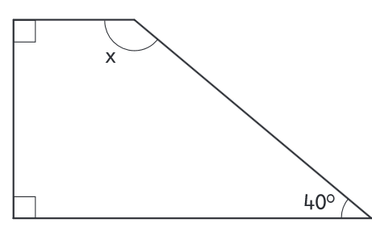
Missing angles in quadrilaterals
Remember
  A quadrilateral is any shape with 4 straight sides
    E.g. square, rhombus, rectangle, trapezium, parallelogram
  The angles in a quadrilateral add up to 360°
  90° + 90° + 40° = 220°
  360° - 220° = 140°

Slide 9
Calculating missing angles
180°
Angles on a straight line add up to 180°
Angles in a triangle add up to 180°
360°
Angles in a full turn add up to 360°
Angles in a quadrilateral add up to 360°
Intersecting Lines
Opposite angles are equal
The angles add up to 360°
You should now be able to complete all questions.

