Slide 1
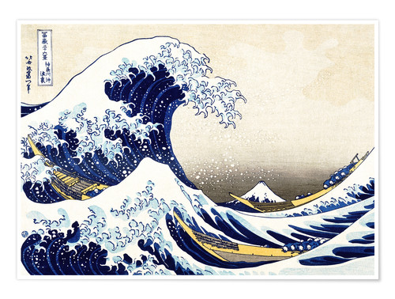

Slide 2
The Great Wave
Full title- The Great Wave off Kanagawa.
Created by Katsushika Hokusai

Slide 3
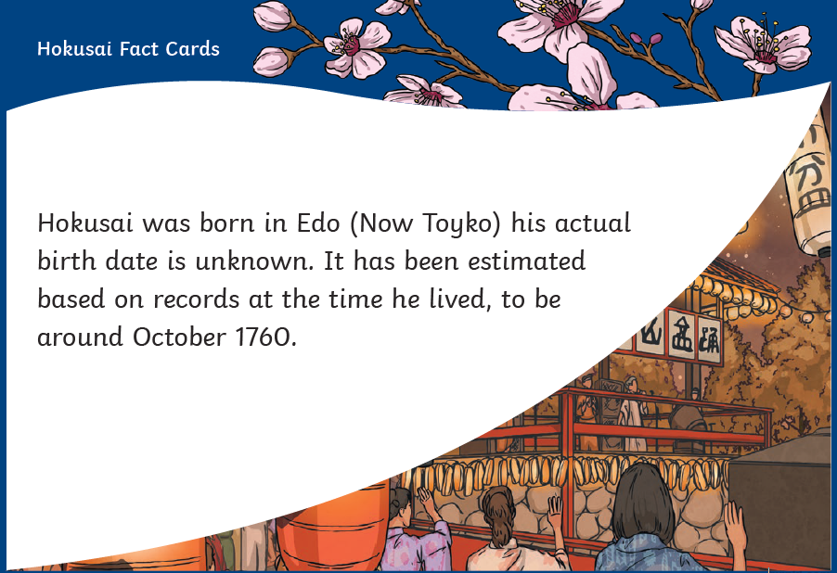

Slide 4
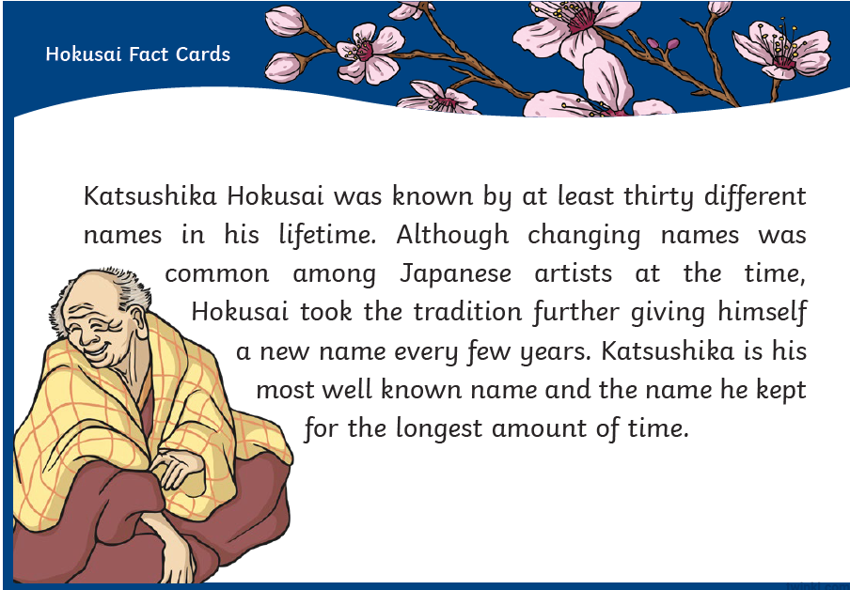

Slide 5
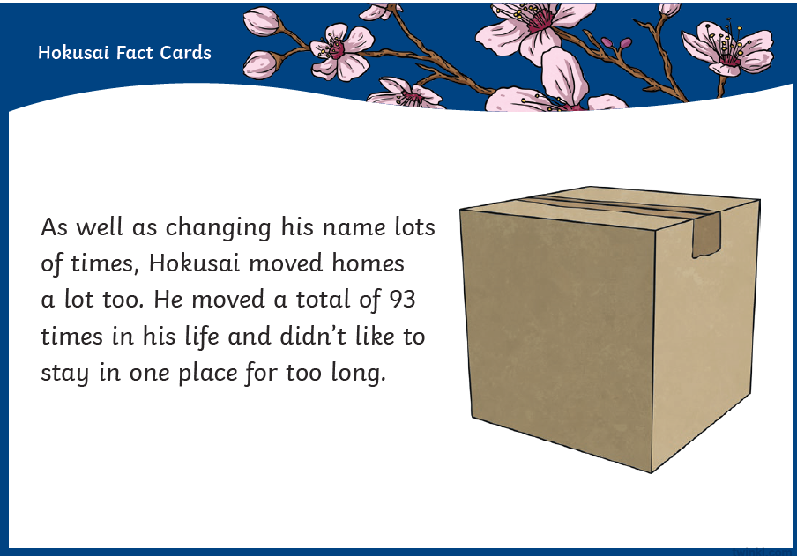

Slide 6
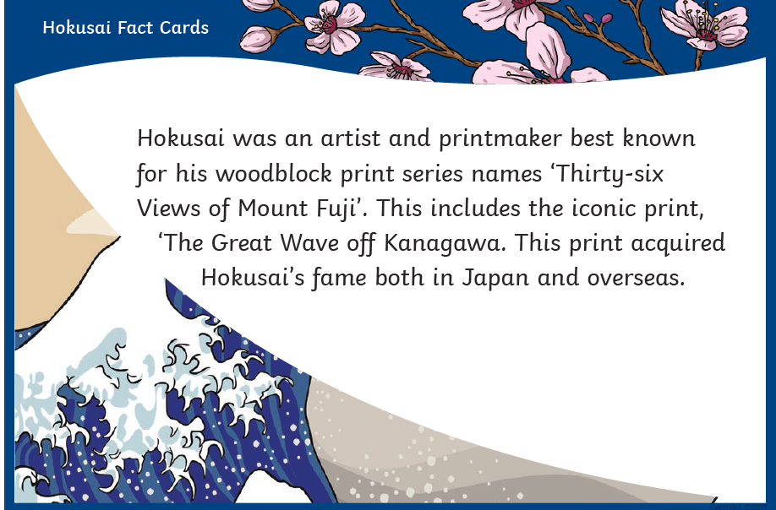

Slide 7
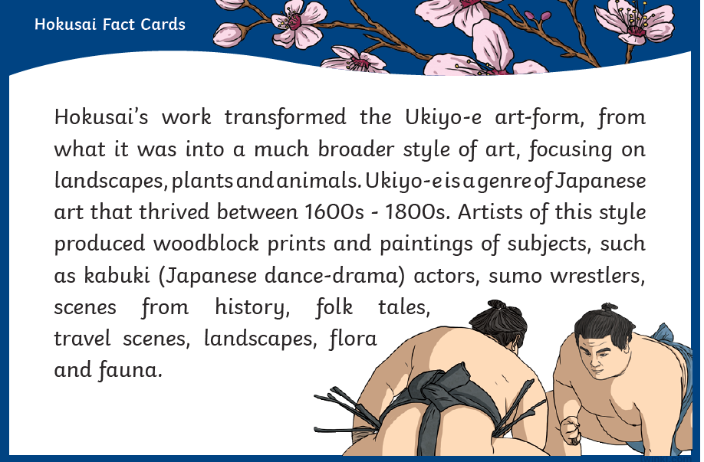

Slide 8
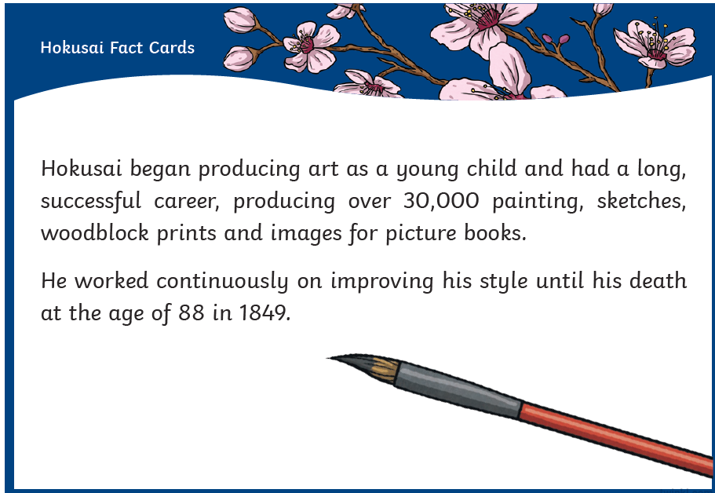

Slide 9
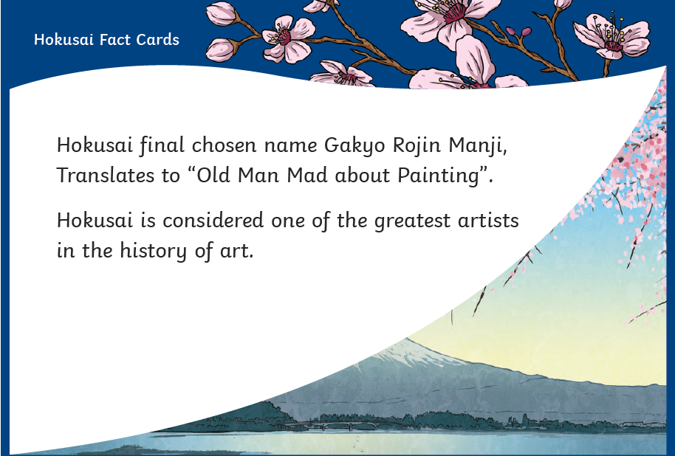

Slide 10
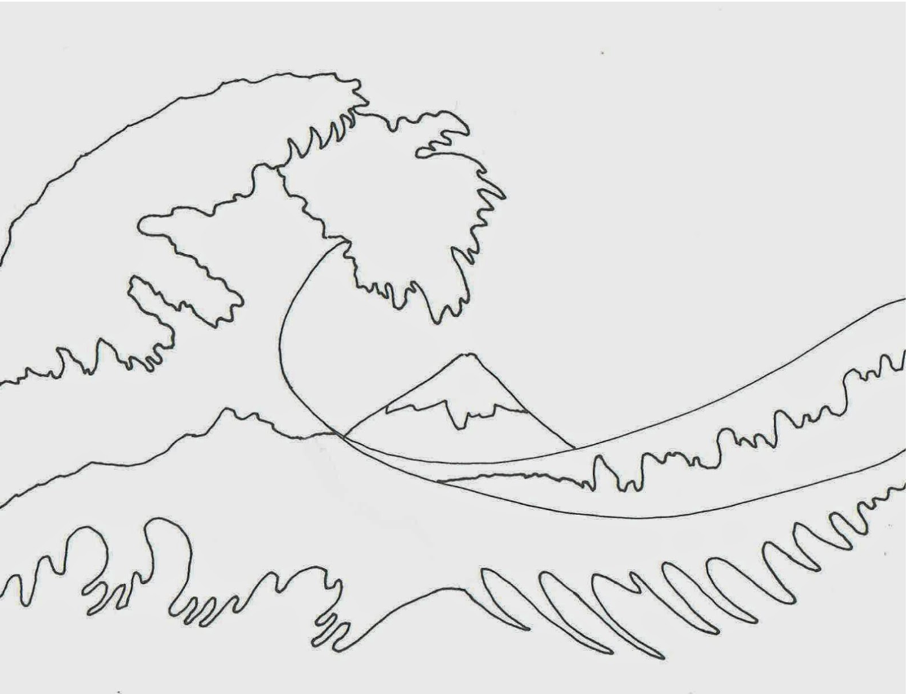
Today’s tasks:
Write down 5 facts about Hokusai.
Re-create ‘The Great Wave’!
You can try to copy Hokusai as closely as possible.
You could use totally different colours. You could use paint or a digital app!
You could make the waves stripy or spotty! Remember Zentangle Art?
You could add a character onto the wave!
See examples on the next slide….

Slide 11


