Slide 2
Teacher Guidance
Sky, Grass and Ground handwriting prompts allow young children to clearly visualise where letters should be placed on the page, encouraging correct letter formation, size and placement.
These resources provide a visual prompt, reminding students which letters start in the sky (blue), which start in the grass (green) and which have tails that need to drop below the line into the ground (brown).
This strategy allows for explicit teaching of which letters are ‘sky’ letters, which are ‘grass’ letters, and which are ‘ground’ letters:
  sky: all capital letters; b, d, f, h, k, l, t
  grass: a, c, e, i, m, n, o, r, s, u, v, w, x, z
  ground: g, j, p, q, y
Provide verbal prompts to accompany the visual prompt. For example:
  “Tall letters start in the sky.”
  “Short letters stay on the grass.”
  “Tails have roots in the ground.”

Slide 3
Select a Letter
Aa
Bb
Cc
Dd
Ee
Ff
Gg
Hh
Ii
Jj
Kk
Ll
Mm
Nn
Oo
Pp
Qq
Rr
Ss
Tt
Uu
Vv
Ww
Xx
Yy
Zz

Slide 4


Letter Aa
Back
A
apple
a

Slide 5

Letter Bb
Back
B
ball
b

Slide 6

Letter Cc
Back
C
cat
c

Slide 7
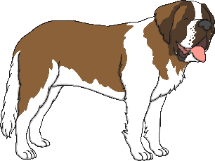

Letter Dd
Back
D
dog
d

Slide 8

Letter Ee
Back
E
egg
e

Slide 9
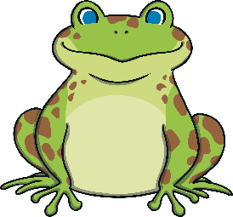
Letter Ff
Back
F
frog
f

Slide 10
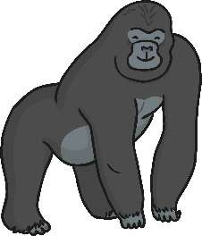
Letter Gg
Back
G
g
gorilla

Slide 11

Letter Hh
Back
H
hat
h

Slide 12

Letter Ii
Back
I
igloo
i

Slide 13
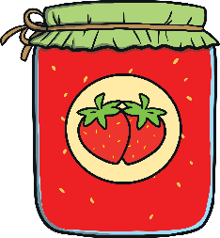
Letter Jj
Back
J
j
jam

Slide 14
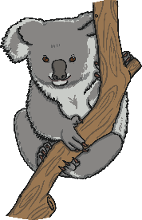
Letter Kk
Back
K
koala
k

Slide 15
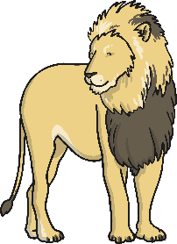
Letter Ll
Back
L
lion
l

Slide 16
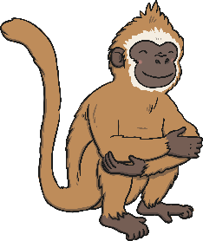
Letter Mm
Back
M
monkey
m

Slide 17
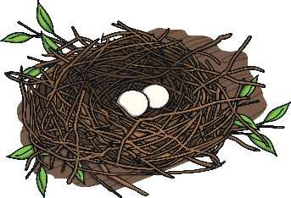
Letter Nn
Back
N
nest
n

Slide 18
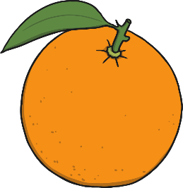
Letter Oo
Back
O
orange
o

Slide 19

Letter Pp
Back
P
pineapple
p

Slide 20
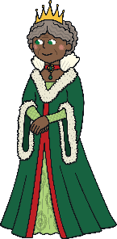
Letter Qq
Back
Q
queen
q

Slide 21

Letter Rr
Back
R
robot
r

Slide 22

Letter Ss
Back
S
sun
s

Slide 23

Letter Tt
Back
T
t
tiger

Slide 24

Letter Uu
Back
U
umbrella
u

Slide 25

Letter Vv
Back
V
vase
v

Slide 26

Letter Ww
Back
W
watch
w

Slide 27
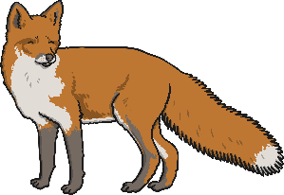
Letter Xx
Back
X
fox
x

Slide 28
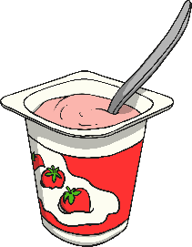
Letter Yy
Back
Y
yoghurt
y

Slide 29
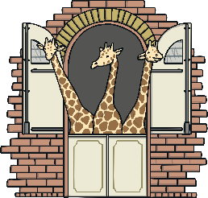
Letter Zz
Back
Z
zoo
z

