Slide 1
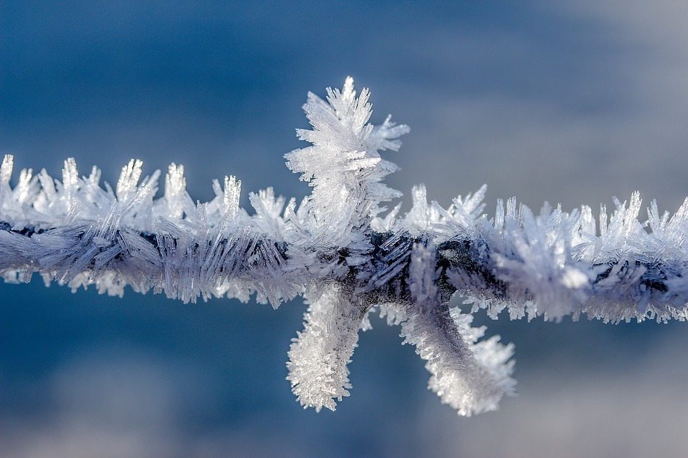
Frost
You may wish to delete this slide before beginning the presentation.

Slide 2

Ice
You may wish to delete this slide before beginning the presentation.

Slide 3
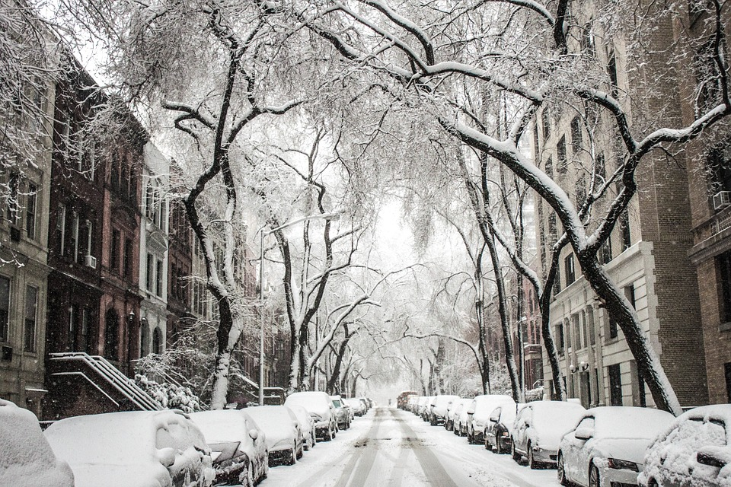
Snow
You may wish to delete this slide before beginning the presentation.

Slide 4
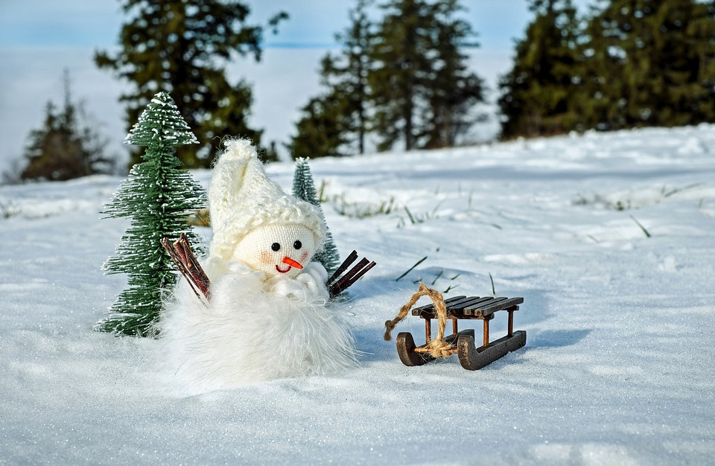
Snowman
You may wish to delete this slide before beginning the presentation.

Slide 5
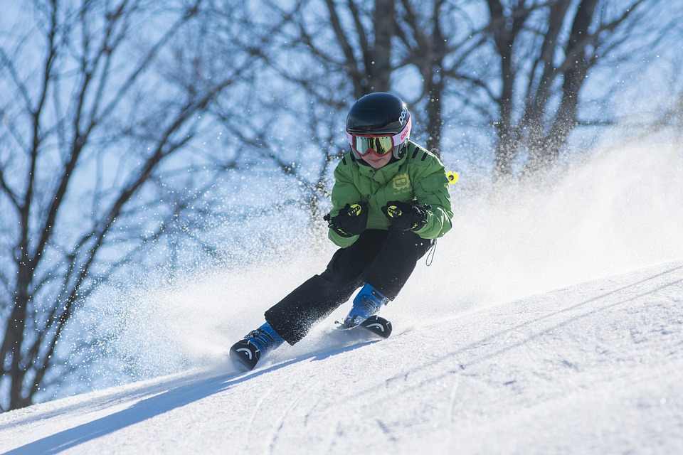
Skiing
You may wish to delete this slide before beginning the presentation.

Slide 6
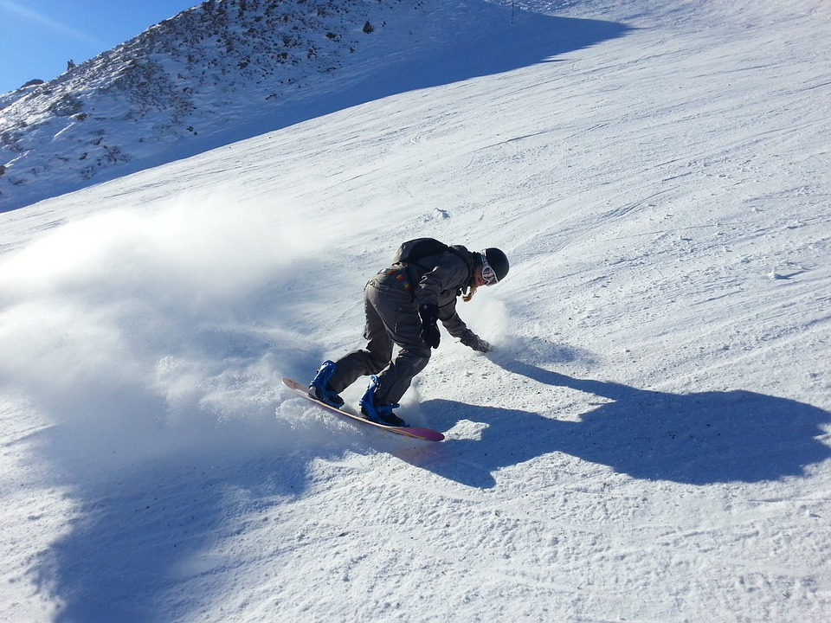
Snowboarding
You may wish to delete this slide before beginning the presentation.

Slide 7
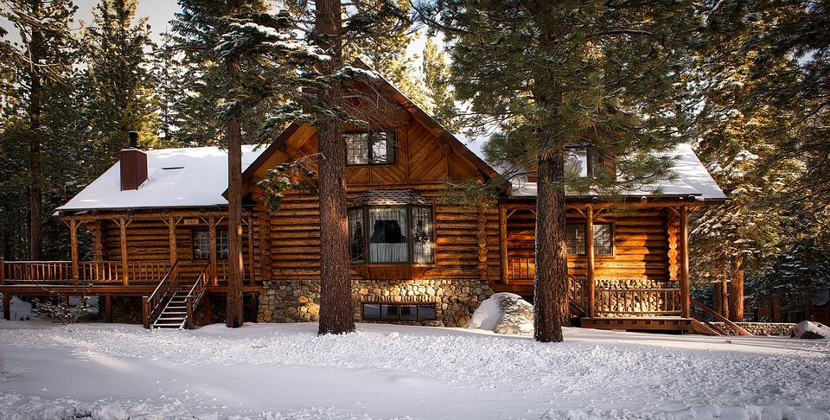
Log Cabin
You may wish to delete this slide before beginning the presentation.

Slide 8
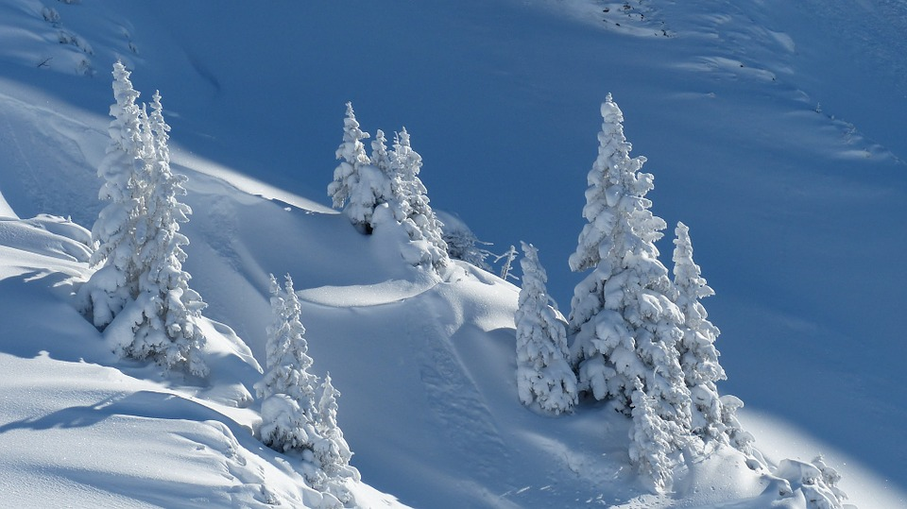
Trees
You may wish to delete this slide before beginning the presentation.

Slide 9
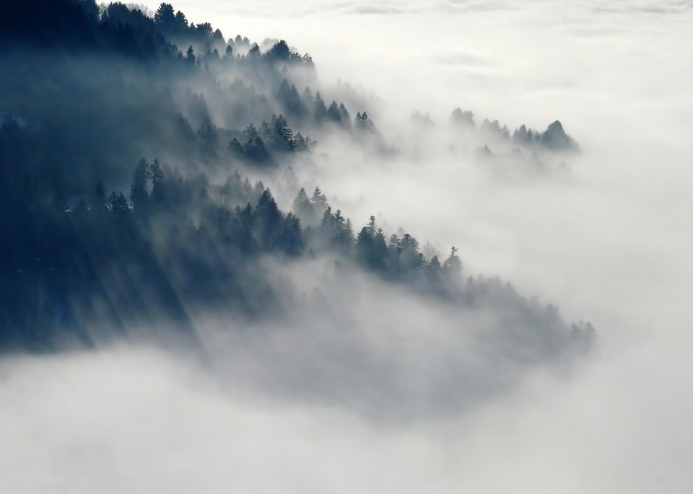
Fog
You may wish to delete this slide before beginning the presentation.

Slide 10
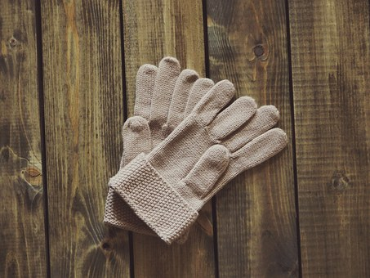
Gloves
You may wish to delete this slide before beginning the presentation.

Slide 11
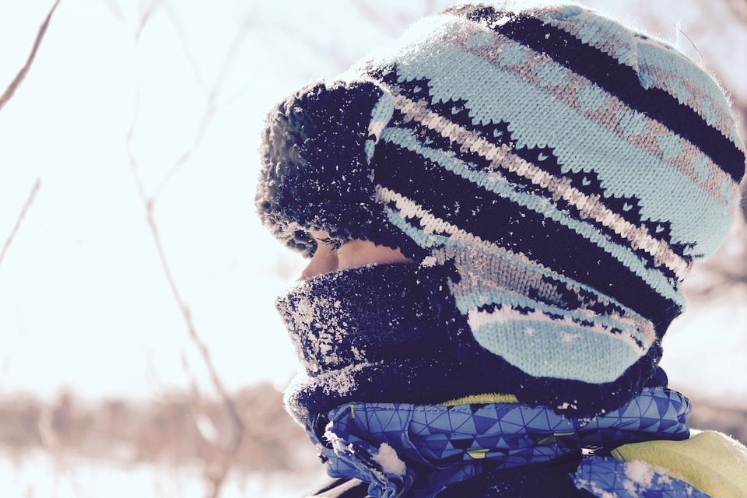
Hat
You may wish to delete this slide before beginning the presentation.

Slide 12
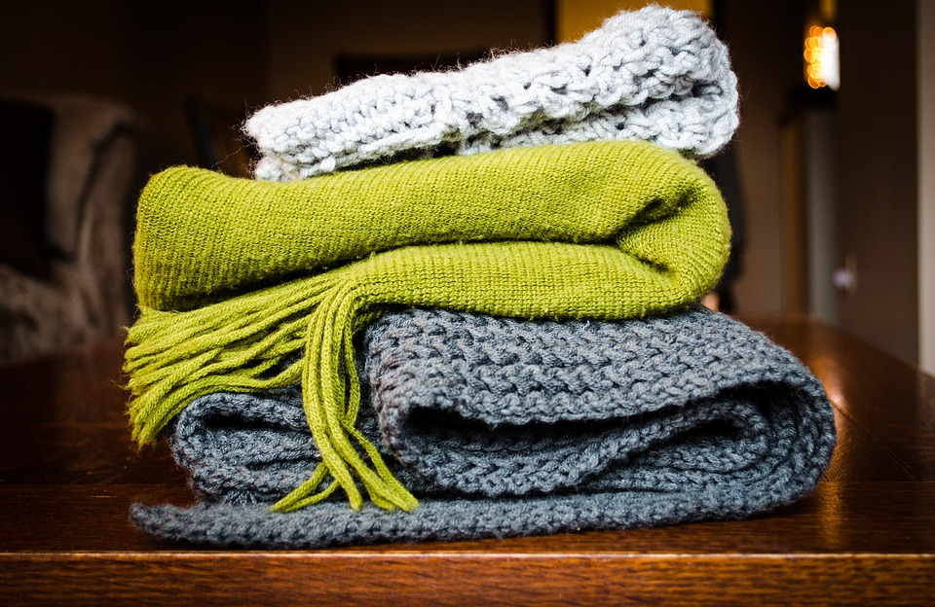
Scarf
You may wish to delete this slide before beginning the presentation.

